Slide 1
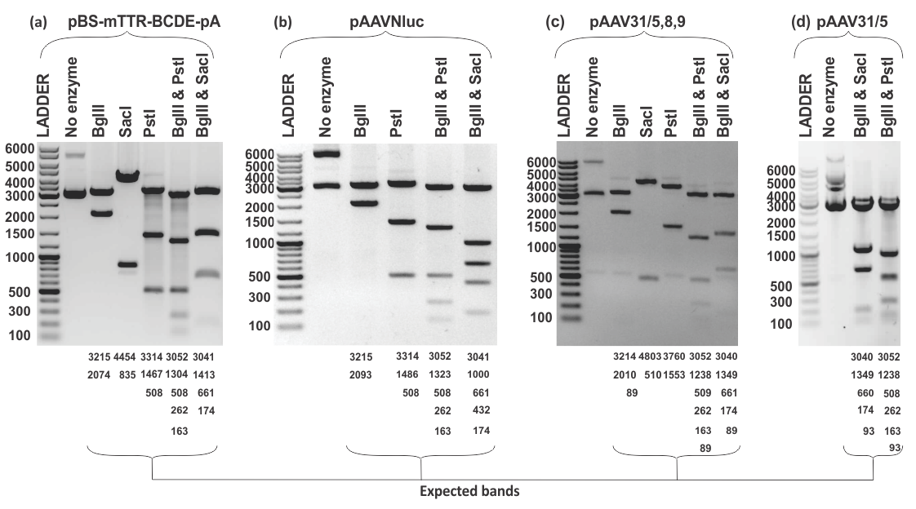
Figure S1: Restriction mapping analysis of plasmids used in scAAV vector production, (a – d) Gel electrophoresis images of plasmids either digested with various enzymes or undigested. The plasmid names are denoted on top, and expected banding patterns denoted at the bottom with ladder molecular weight sizes indicated on the left side. Black arrow indicates unexpected band resulting from partial digestion of plasmid pAAV31/5,8,9.

Slide 2
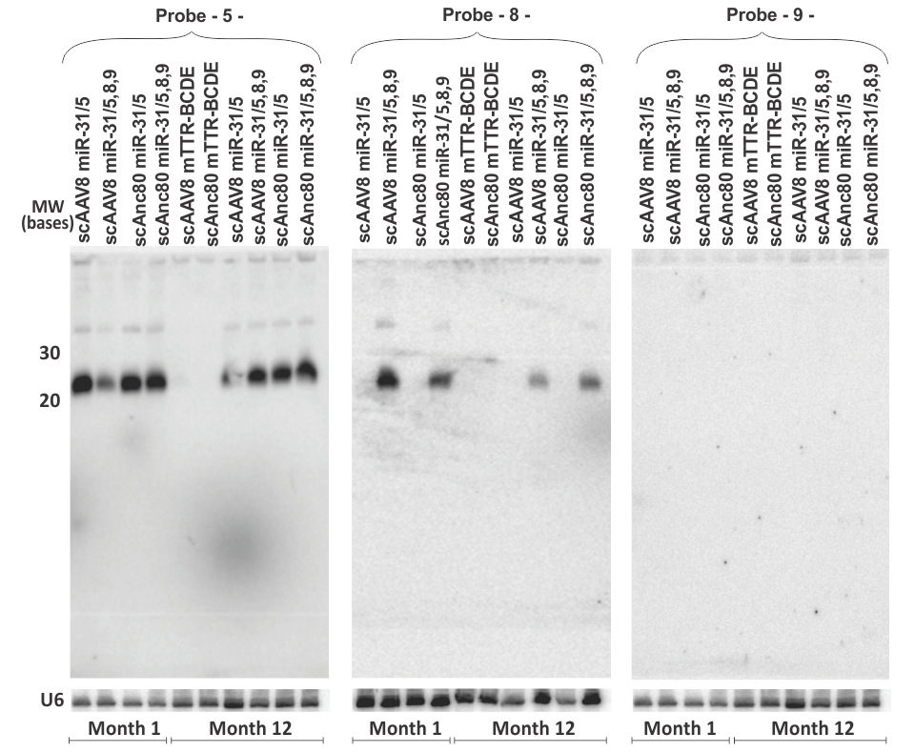
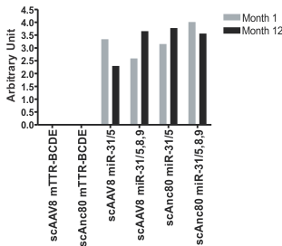
Figure S2: Full blots showing scAnc80 mediated long-term hepatic expression of apri-miR: Northern blot hybridization was performed on total RNA extracted from murine liver samples at 1 or 12 moths post infection with scAAVs. Probes complementary to sequence guides 5, 8 or 9 were hybridized to the blot for detection of mature guides. After stripping the blot, rehybridization with a probe complementary to U6 small nuclear RNA was carried out to confirm equal loading. Data reflect a representative of three mice per group. MW – molecular weight. Black and red arrows indicated processed miR guides (22 nt), and unprocessed or partially processed pri-miRs. The plot represent miR-5 band intensities quantified using Image J software relative to U6 RNA quantities.

Slide 3
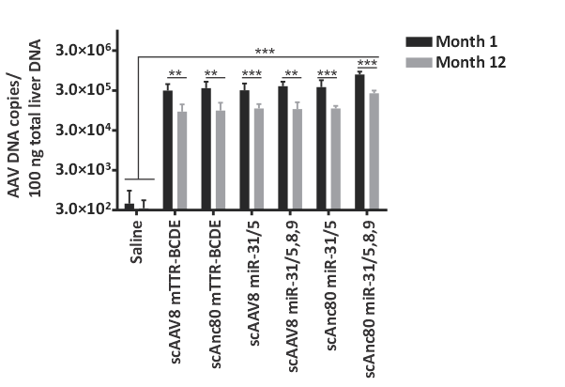
Figure S3: scAn80 genome stability in the liver: Mice were injected with saline or scAAVs at a dose of 1 × 10¹¹ viral particles. Measurement of scAAV VPEs per 100 ng of total hepatic DNA extracted from mice sacrificed at 1 and 12 months post vector infection was done using quantitative PCR technique. The means (±SEM) were derived from n = 4 or 5 mice per group. The one-way ANOVA was used to ascertain statistically significant differences between saline and scAAV groups for months 1 and 12, respectively, these are indicated by asterisks, p‑values < 0.05 (*), < 0.001 (**), < 0.0001 (***) were regarded as statistically significant., p‑values ≥ 0.05 were regarded as statistically insignificant.

Slide 4
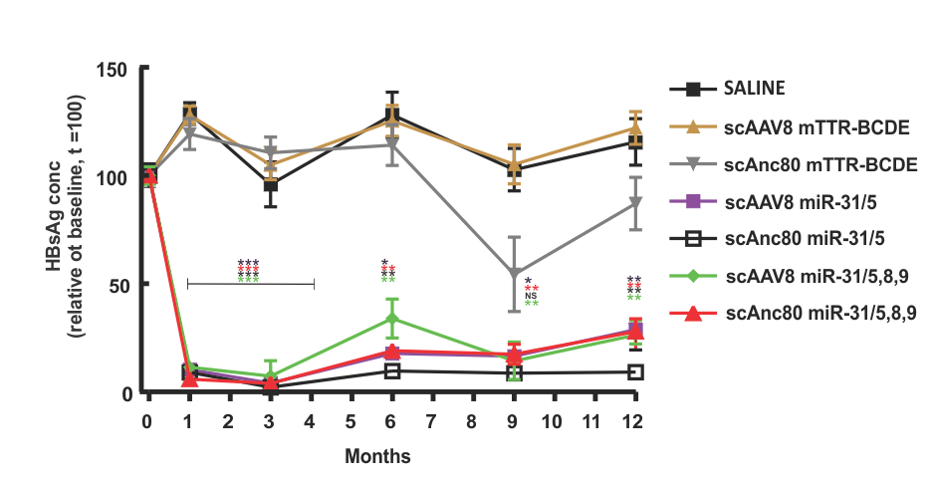
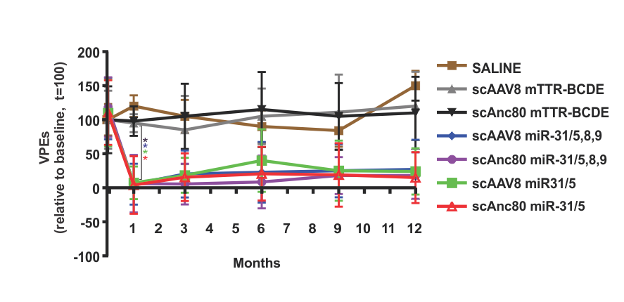
(a)
SALINE
scAnc8 mTTR-BCDE
scAnc80 mTTR-BCDE
scAAV8 miR31/5,8,9
scAnc80 miR31/5,8,9
scAAV8 miR31/5
scAnc80 miR31/5
(b)
SALINE
scAnc8 mTTR-BCDE
scAnc80 mTTR-BCDE
scAAV8 miR31/5,8,9
scAnc80 miR31/5,8,9
scAAV8 miR31/5
scAnc80 miR31/5
Fure S4: HBsAg and VPE levels relative to baseline: HBV transgenic mice were injected intravenously with saline or scAAV at 1 × 10¹¹ scAAV genome copies. HBsAg (a) and VPEs (b) in serum was measured thereafter for a 12-month period and presented relative to measurements taken prior scAAV administration. The means (±SEM) were derived from n = 4 - 6 mice per group. The one-way ANOVA was used to ascertain statistically significant differences relative to anti-HCV vector controls, these are indicated by asterisks, p‑values < 0.05 (*),< 0.001 (**), < 0.0001 (***) were regarded as statistically significant, p‑values ≥ 0.05 were regarded as statistically insignificant.

Slide 5
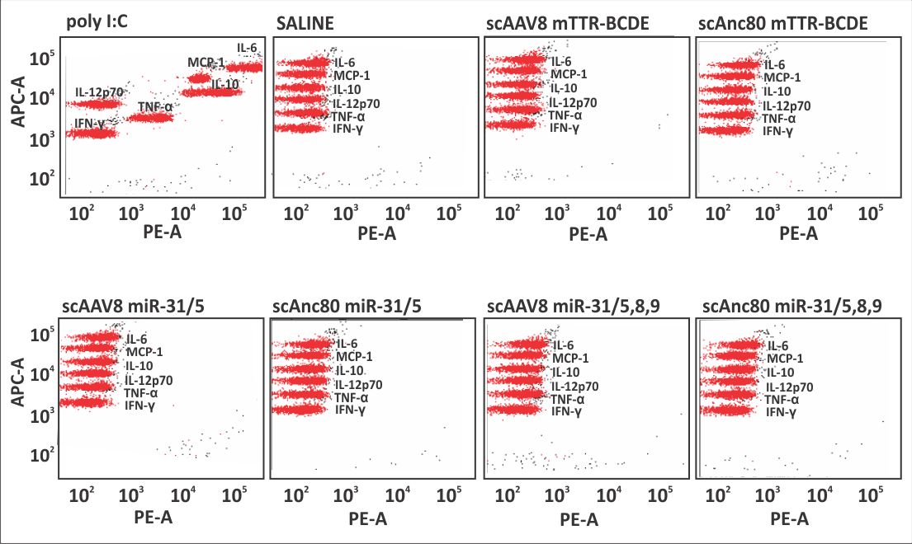
Figure S5: Representative dot blot representation of cytokine quantitation. Serum levels of IFN-γ, IL-12p70, TNF-α, IL-6, MCP-1, and IL-10 were quantified 6 hours post injection with scAAVs, saline or poly (I:C).

