Slide 1
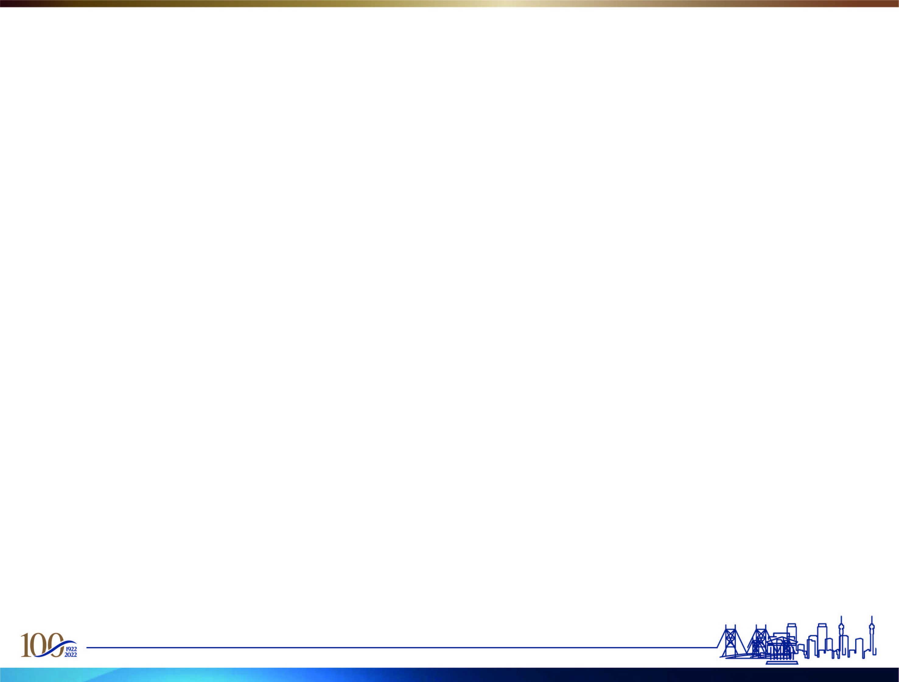

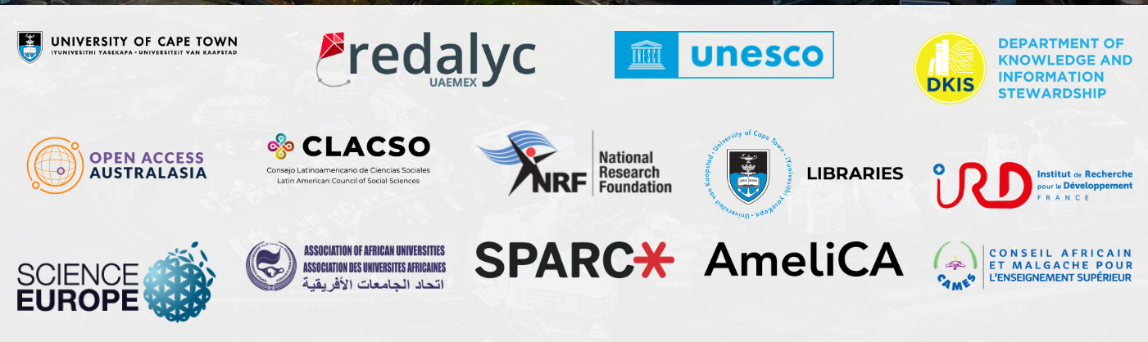
Elevating African Researchers’ Visibility and Impact Using an Open Science Africa Accelerator Tool
Lazarus Gallant Matizirofa
3rd Edition of Open Science in the South Conference, 9-11 December 2024 &
Conference on Diamond Open Access, 11-13 December 2024, Cape Town, South Africa

Slide 2
Background
This presentation is a novelty of the Open Science Africa Accelerator Tool (OSAA Tool) designed to promote and enhance the adoption of open science practices in Africa. Research Visibility Impact (RVI) is usually measured using article impact factors, webometrics, and more recently Altmetrics.
The use of the Research(er) Visibility Tools (RVTs) has not been widely adopted in Africa, but it is needed to stimulate open publishing and open data stewardship so that African scholarly publishing and dissemination of research outputs can contribute to citizen science or the public good of knowledge.
This can be achieved if academic or research libraries develop Research Visibility Monitoring tools, such as the OSAA Tool, which can then be used to drive and encourage researchers to become visible and ensure that their research outputs are more accessible globally.

Slide 3
Problem Statement
Only a few African higher education institutions or science councils have internal strategies to monitor Research Visibility and Impact (RVI). Most such organisations rely heavily on service provider platforms (Commercial systems).
Therefore, an institutional mechanism or tool such as the innovative OSAA Tool could promote open science practice, the use of open repositories, and other open research platforms such as Open Journal Systems (OJS, Open Monograph Press (OMP), and Open Educational Resources (OERs) effectively but encouraging researchers to create Online Researcher Profiles (OPRs).
OSAA Tool, as an OS accelerator, stimulates the engagement of scholars, collaborations, and social networking, ensuring that research processes and outcomes are more inclusive and visible. There is also a perception that researchers do not have time to manage their profiles; hence, they lose out on the benefits of Open Science. This makes the task more complex for librarians to promote open science transformation in Africa, without using open science tools, such as the OSAA Tool.

Slide 4
Research Methodology
The OSAA Tool platform (survey) can be deployed periodically by libraries or research offices to enhance and ensure that researchers participate and gain the most from their research outputs, i.e., citations and alternative metrics are fundamental bases for best practices in scholarly communication.
Researchers should be motivated to use tools that foster open collaboration and data sharing to accelerate and enhance knowledge productivity, innovation, and scientific research efficiency.
Open Science should be an agenda for every researcher, to ensure a wider reach of research outputs, and to be accessible to a global audience to maximise or grow research visibility and impact.

Slide 5
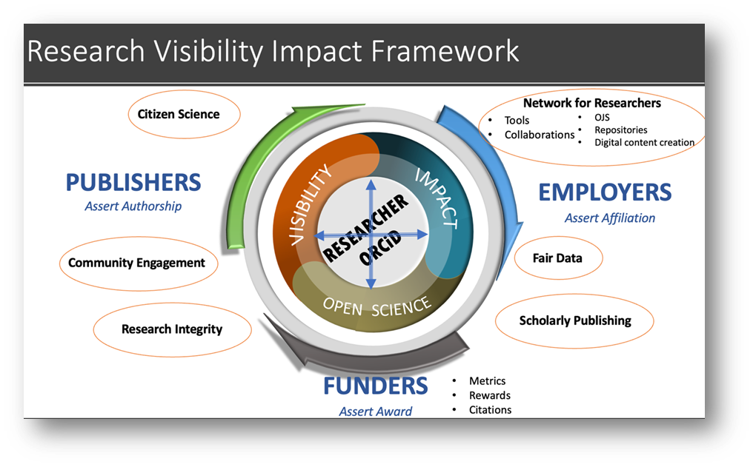

Slide 6
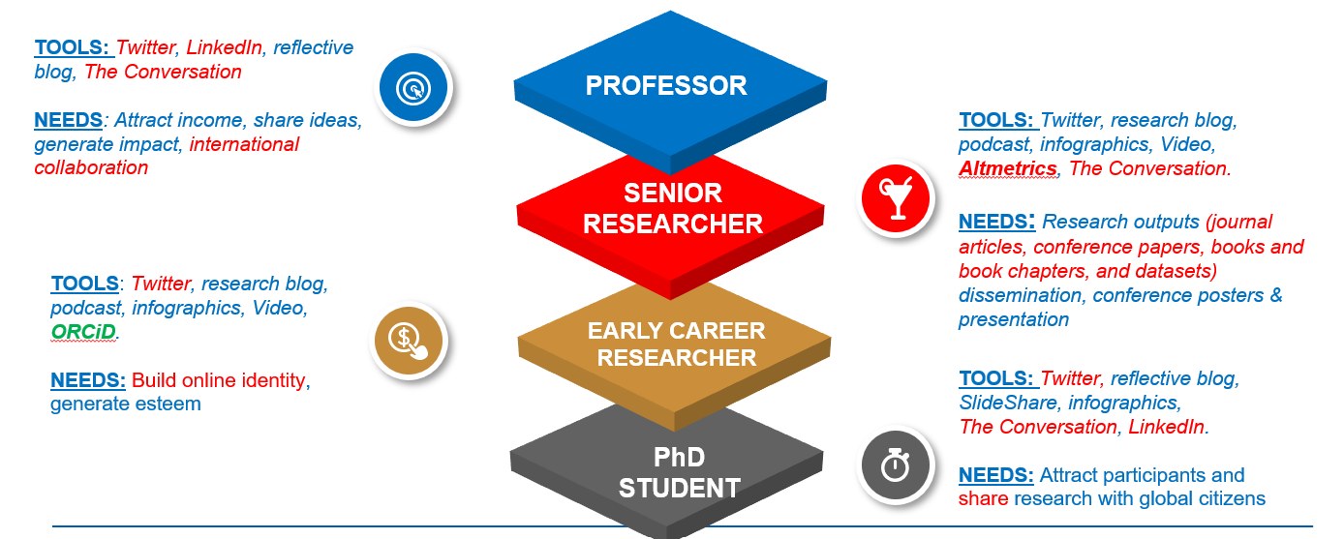
WITS Researcher Ecosystem

Slide 7
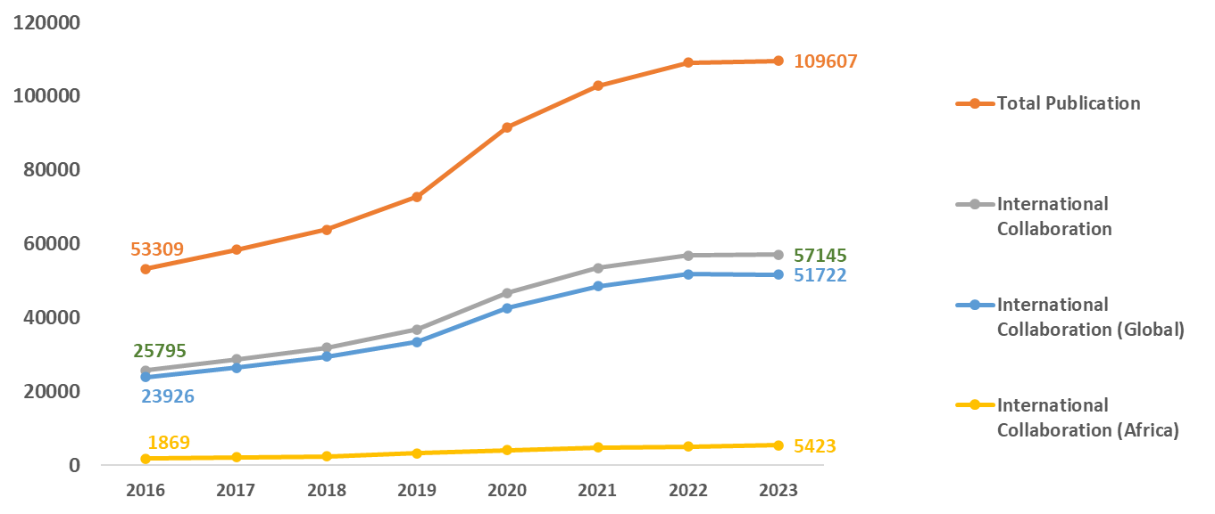
African Research Output (Dimensions – Ann Campbell)

Slide 8
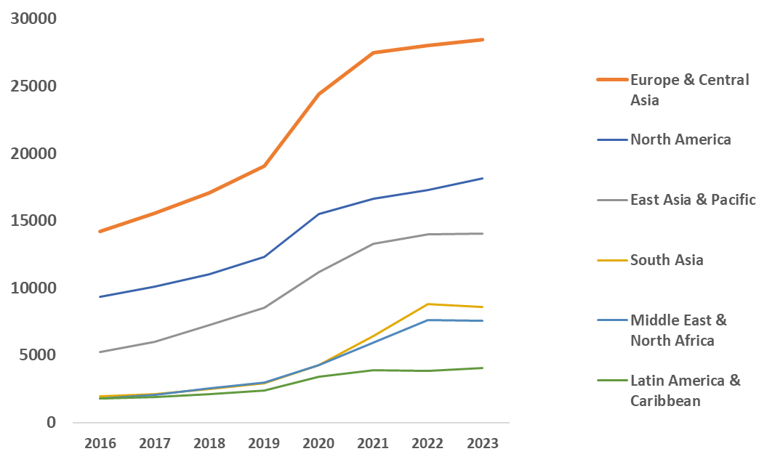
Africa Research Collaborations (Dimensions – Ann Campbell)

Slide 9
WITS RVI Implementation (Researcher Benefits)
The project proposes launching a campaign across the campus to improve the visibility and impact for WITS researchers – both postgraduate students and academics or researchers. The pitch for such an institutional strategic campaign will focus on these points.
Raising the researcher’s productivity impact factor will generate more international and local attention for such research output/collaborations.
More visibility generates more collaborative prospects and the ability to partner with colleagues across disciplines, institutions, and borders – effectively diversifying one’s research capacity.
A higher visibility and impact factor will make one’s research more attractive to international funders bolstering your ability to receive third-stream funding.

Slide 10
WITS Researcher Online Profiles (Targeted by the RVI)
The academic profile platforms highlighted here, promise open access and the chance to promote research and deepen its impact. We, therefore proposed piloting a campaign to help researchers develop their digital footprint by creating the RVI Tool:
Establishing ORCiD as their primary author identifier to collect their research outputs
Importing publications from Web of Science to develop their Researcher ID on Publons and Scopus Author Identifier – both of which should link to their ORCiD
Assisting scholars to develop their Google Scholar Profiles
Populating a researcher’s institutional author profiles and familiarising researchers with such benefits
Creating individual researcher profiles using Research Data Repository (FigShare) and sharing dimensions and altimetric data (SDGs impact)
Mentoring researchers in how to use social research networks such as LinkedIn, ResearchGate, Mendeley, Academia.edu, Blog, Research blogging, and Twitter to grow their research niche
Introducing emerging researchers to the benefits of Online Researcher Tools
Training younger researchers to distinguish themselves online, to attract future international and interdisciplinary collaborators

Slide 11
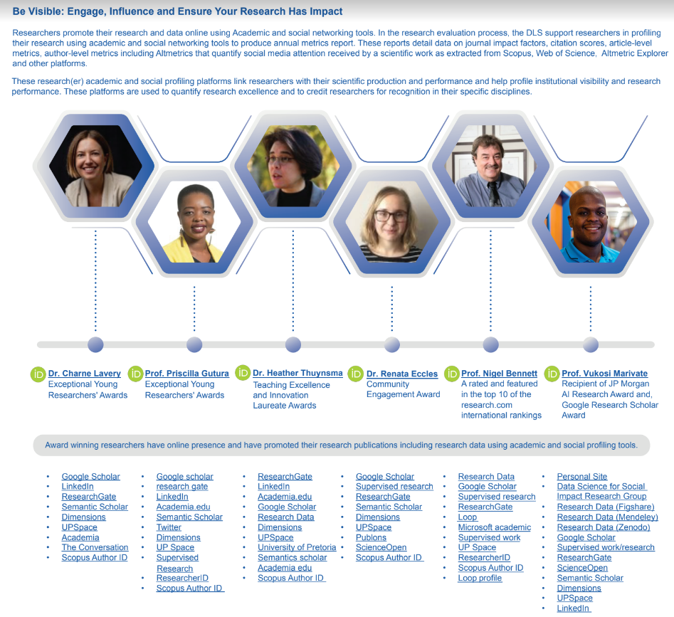
UP’s Trial Results (using the prototype OSAA Tool)
Lazarus Gallant Matizirofa, Veliswa Tshetsha, Heather Thuynsma, A conceptual framework for researcher visibility and impact check tool at two South African universities, Open Science Fair, 25-27 September 2023, Madrid, Spain

Slide 12
Conclusion
The OSAA Tool prototype has already been tested at the University of Pretoria (2023) and is currently under implementation at the University of the Witwatersrand (2024).
It was also demonstrated at the Open Science Fair conference (#OSFAIR2023): Charting the course: Reimagining open science for next generations, Sept 25-27, 2023, in Madrid, Spain. The use of the OSAA Tool by other universities and science councils in Africa will encourage researchers to better understand the open science research cycle. This will facilitate the use of ORPs as plug-ins to make it easier for researchers to access and share scientific knowledge, thus supporting the principles of open science in Africa.
Therefore, linking to Open Access publications, Open Data, OERS, ORCID, and various Open Science tools. The completeness of ORPs may vary, but this tool has demonstrated that it creates a researcher’s science communication, science engagement, and contribution to Society 5.0 and Sustainable Development Goals (SDGs).
It is anticipated that further innovation and investment in the OSAA Tool will drive African HEIs and Science Councils to grow and contribute to the global Open Science movement.

Slide 13
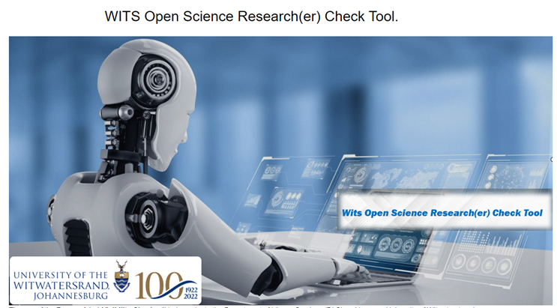

Demo - https://wits-ac-za.libwizard.com/id/2724d0e8af7e8a1c0c875d8ce4715821

Slide 14
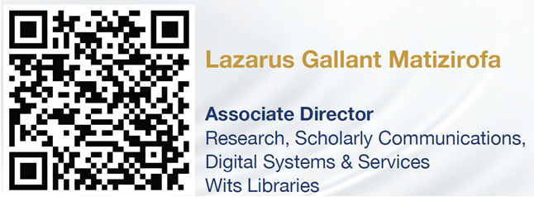
Thank you
PhD Student: Interdisciplinary Digital Knowledge Economy Studies, Witwatersrand University, Johannesburg

