Slide 1
(S)he
Director’s Treatment
By
Sean Steinberg
Student Number: 488154
Addendum B
Mustang. Director. Deniz Gamze Urgüven. Ad Vitam Distribution, 2015. Film
Water Lilies (Naissance des Pieuvres). Director. Céline Sciamma. Haut et Court, 2007. Film
Mustang. Director. Deniz Gamze Urgüven. Ad Vitam Distribution, 2015. Film

Slide 2
Contents
Director/Writer Statement (pg1-2)
Logline & Narrative Synopsis (pg 3)
Cast/Character Profile (pg 4-5)
Casting & Auditions (pg 6-7)
Table Read: Image and Clips (pg 8-10)
Location & Floor Plans: Blocking & Staging (pg 11-30)
Art Direction (pg 31)
Colour Palette (pg 32)
Character Hair and Make-Up (pg 33-36)
Wardrobe Reference (pg 37-39)
Mood Board (pg 40)
Camera & Lighting (pg 41-42)
Edit & Grade (pg 43-44)
Film Reference Clips (pg 45-46)
Music & Score References Clips (pg 47-48)
Shooting Schedule (pg 49-50)
Camera & Gear List (pg 51)
Budget (pg 52)
Poster Image Idea (pg 53)

Slide 3
Director/Writer Statement
(S)he is a coming-of-age drama that speaks to what it means to be a teenager, to be accepted, and to stand up for who you are. But unlike other coming-of-age films, I didn’t want to characterize it by the typified notions of sex and violence. Instead, I wanted to tell a coming-of-age story that was able to to transcend those tropes but still get to the heart of what it means to be a teenager, struggling to find and accept one’s own conflicting identity and in this case, body.
What interested me most about this idea isn’t that my protagonist (Ryann) is merely a 15-year-old student at an all-girls high school, but that she was born physically different to all the other girls. She is intersex (her particular medical classification is Congenital Adrenal Hyperplasia [CAH]), which means her genitals are ambiguous: they are not easily classified as male or female. In creating such a character, I have had the freedom to explore an archetype that is able to speak to all the sex and gender discussions that we are so often faced with in our modern society.

Slide 4
Of course, with the limitations of time presented by the short film format, I have had to remain extremely focused on only a few of the psychosocial and socio-political aspects that could be explored in a dynamic story like this. I have chosen to focus on the importance of inclusivity, body-positivity, body autonomy, and the power of peaceful and intelligent protest for social justice. In addition, the fact that the trio of best friends is racially inclusive (a White girl, a Black girl and an Indian girl) further directs the film’s message towards a goal of friendship and love based on our commonalities rather than on our differences. It reminds us of how far we have come but also asks us to consider where we are still falling short and to keep fighting for the society that every human being deserves.
My commitment to this story is simple - to stand back and tell it honestly. Precisely because the story branches out so far and touches so many, because the themes are so seismic, the rendering needs to be subtle, humane and uncluttered. I want to let the drama unfold with something akin to a documentary realism in order to capture the nuance of coming of age.

Slide 5
Logline and Narrative Synopsis
Logline: An intersex teenager who is ostracized from her swimming team must rise up against her team mate’s prejudice and fight for who she is.
Synopsis: Set in an all-girls-school, an intersex teenager, Ryann (15), who is on the first team for swimming, is asked to switch swimming strokes with one of her teammates. As a result, Ryann is prejudiced against and ostracized and made out to be some kind of monster. But with the love and support from her parents and her two best friends, she finds the strength in herself to rise up, like the women of the 1956 Woman’s March, to take on the establishment. Love and moments of sacrifice bring about a coming-of-age story committed to the struggle against social prejudice and injustice.

Slide 6
Cast/Character Profile
*Cast is non-contractual
Ryann Kemp
Mildly androgynous
Emotionally mature
An excellent swimmer.
Zoe
Tomboyish
Fun and Quirky
A true rebel
Ashley
Ryann’s foil
Jealous
Can be nasty
Shey
A diligent student
A little shy
Arty

Slide 7
Cast/Character Profile
*Cast is non-contractual
Paul Kemp
Owns a construction company
Liberal but fights for what is right
Mrs. Burke
Everything you would expect a history teacher to be - old and grumpy and organized
Maree Kemp
A working woman
Fun but pragmatic
Miss Hart
Clean cut
Straight to the point
Often gets herself in over her head

Slide 8
Casting and Auditions
The process of casting initially dealt with the age of the child actors versus their characters. I insisted on casting actors that respectively suited the roles they that were going to play, in order to present the story in its most realistic light, i.e. 15-years-olds being 15-year-olds. From that point, I put out a cattle call to four schools; Crawford College, Saint Mary’s, Reddam House and Redhill.
Over a five month period I auditioned actors from all of these school. Beginning with an initial call I got a sense of which actors had the right look, energy and talent in order to portray their given characters. Actors were given sections of the script to prepare for the auditions. During the audition they were given notes in order to see if they could take direction. This was followed by a call back session, in which I called back the top choices from the initial casting sessions. This took the same format as the initial casting session. Subsequent to reviewing this footage, the final actors were chosen to take part in a screen test, in which they were all given individual direction in order to see if they worked together on screen.

Slide 9
Having found the perfect young actors who gelled together incredibly well on screen, as well as the adult actors (of whom were selected because they are industry professionals), I consider the casting process to have been incredibly successful. Below is a selection of audition clips put together in order to illustrate the process:
PLEASE SEE THE VIDEO FILE – 1. CASTING AND AUDITIONS

Slide 10
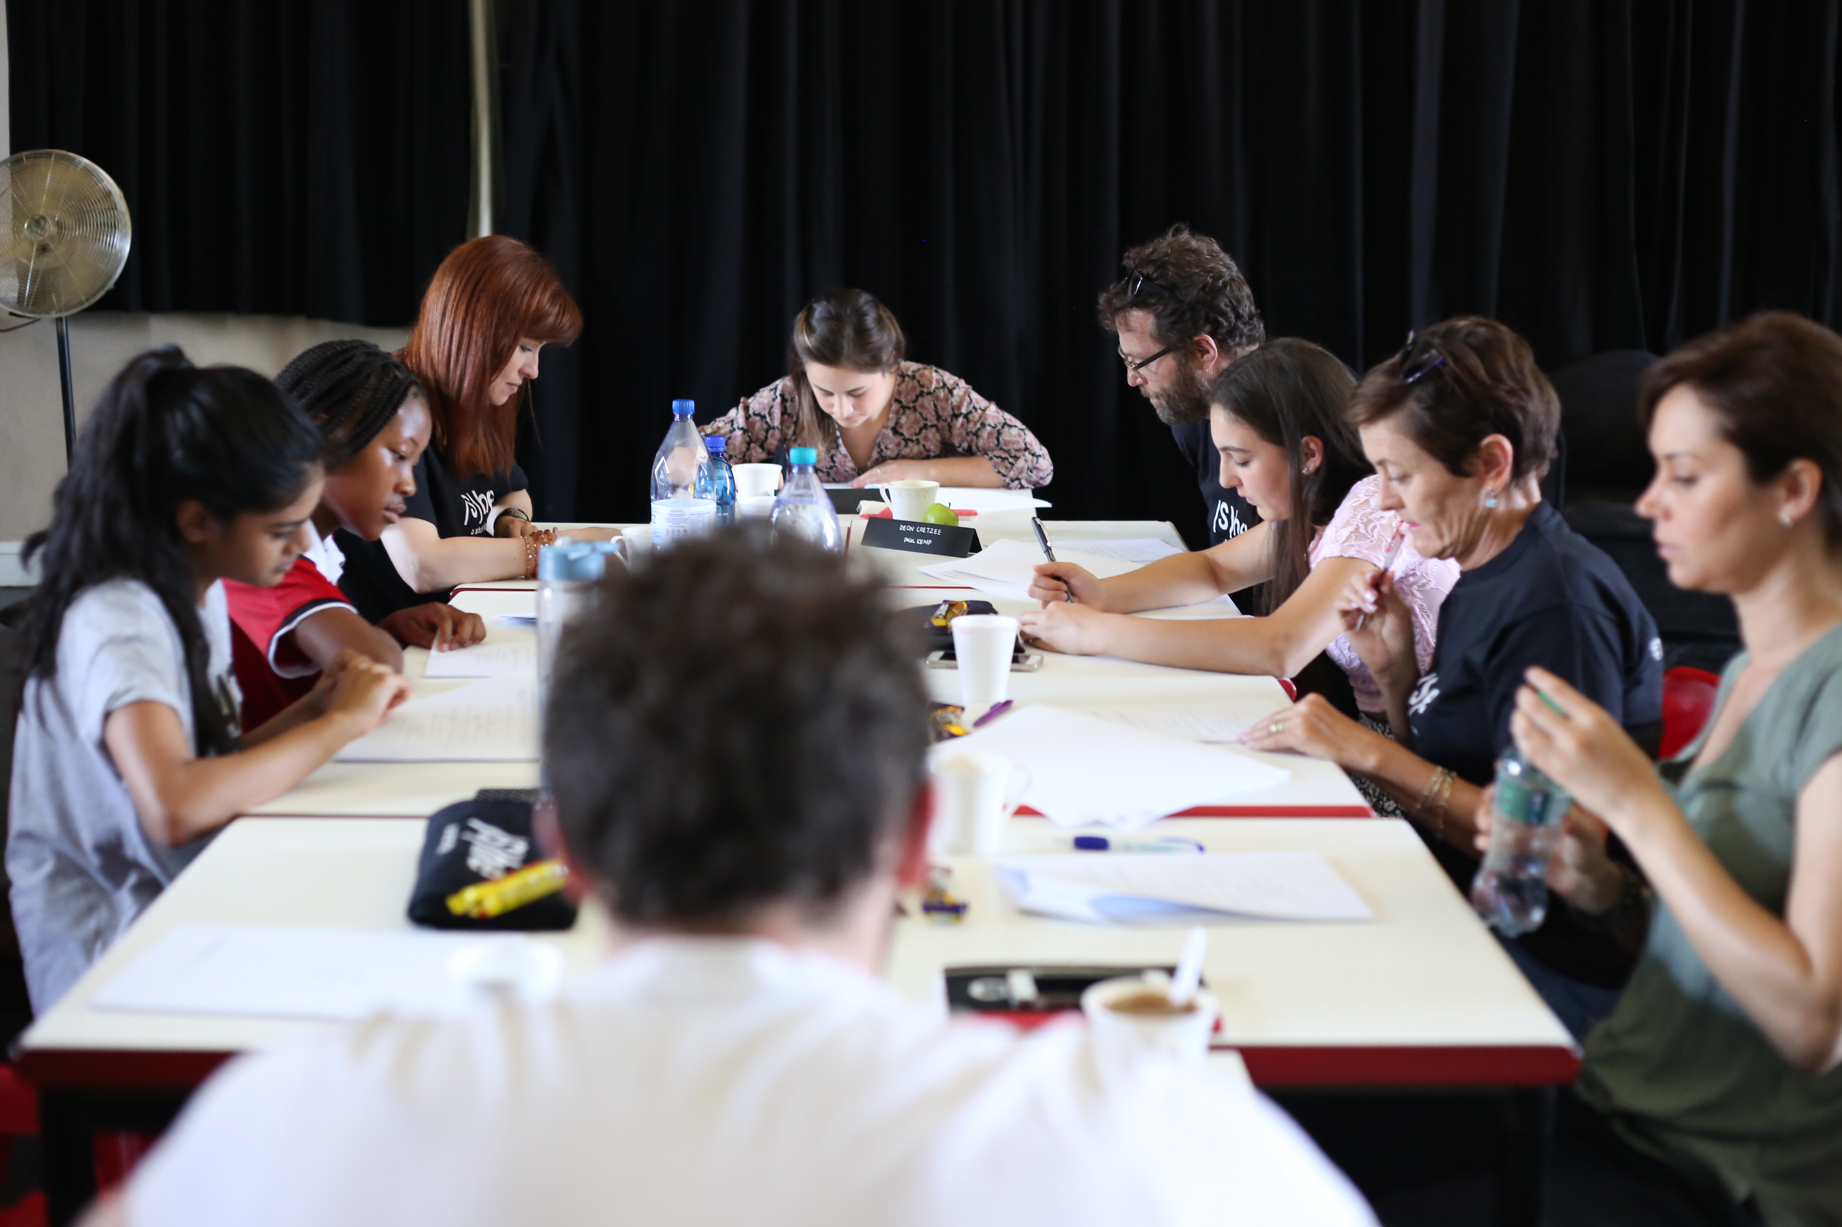
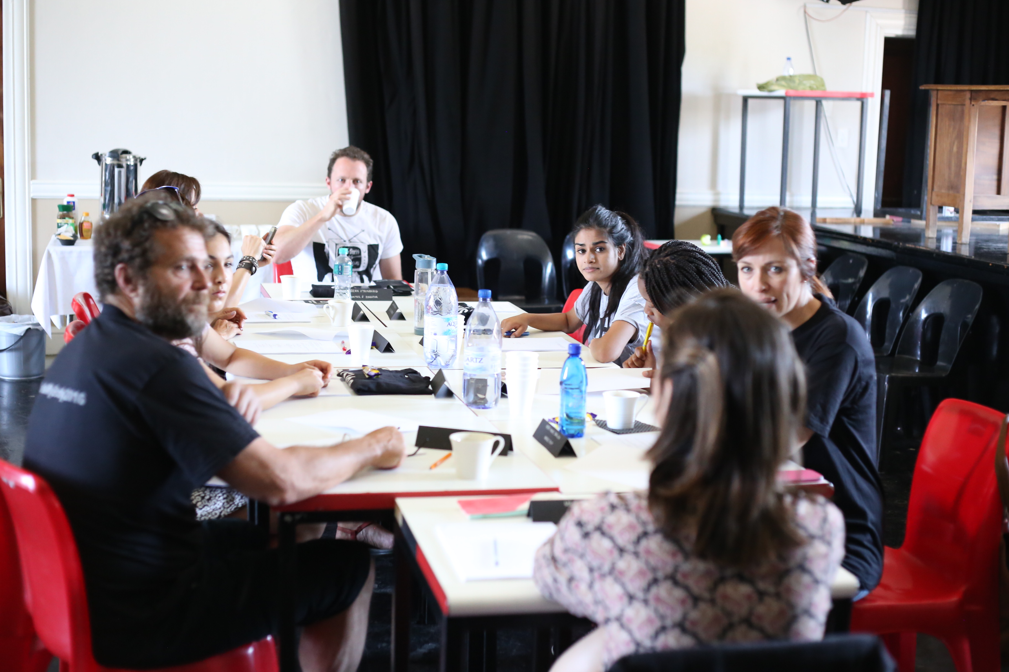
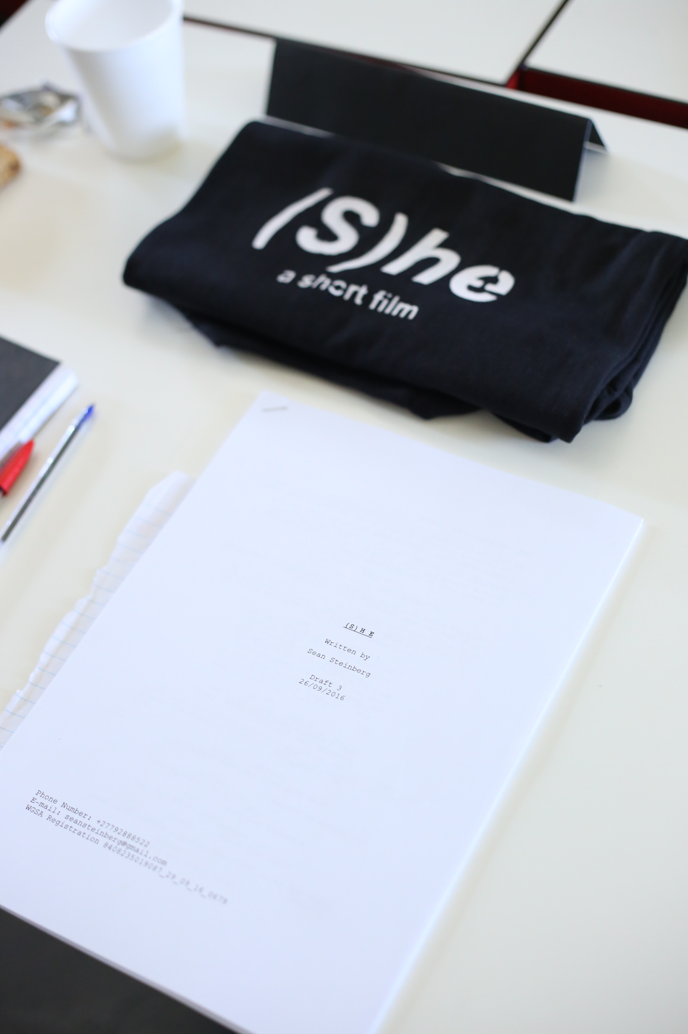
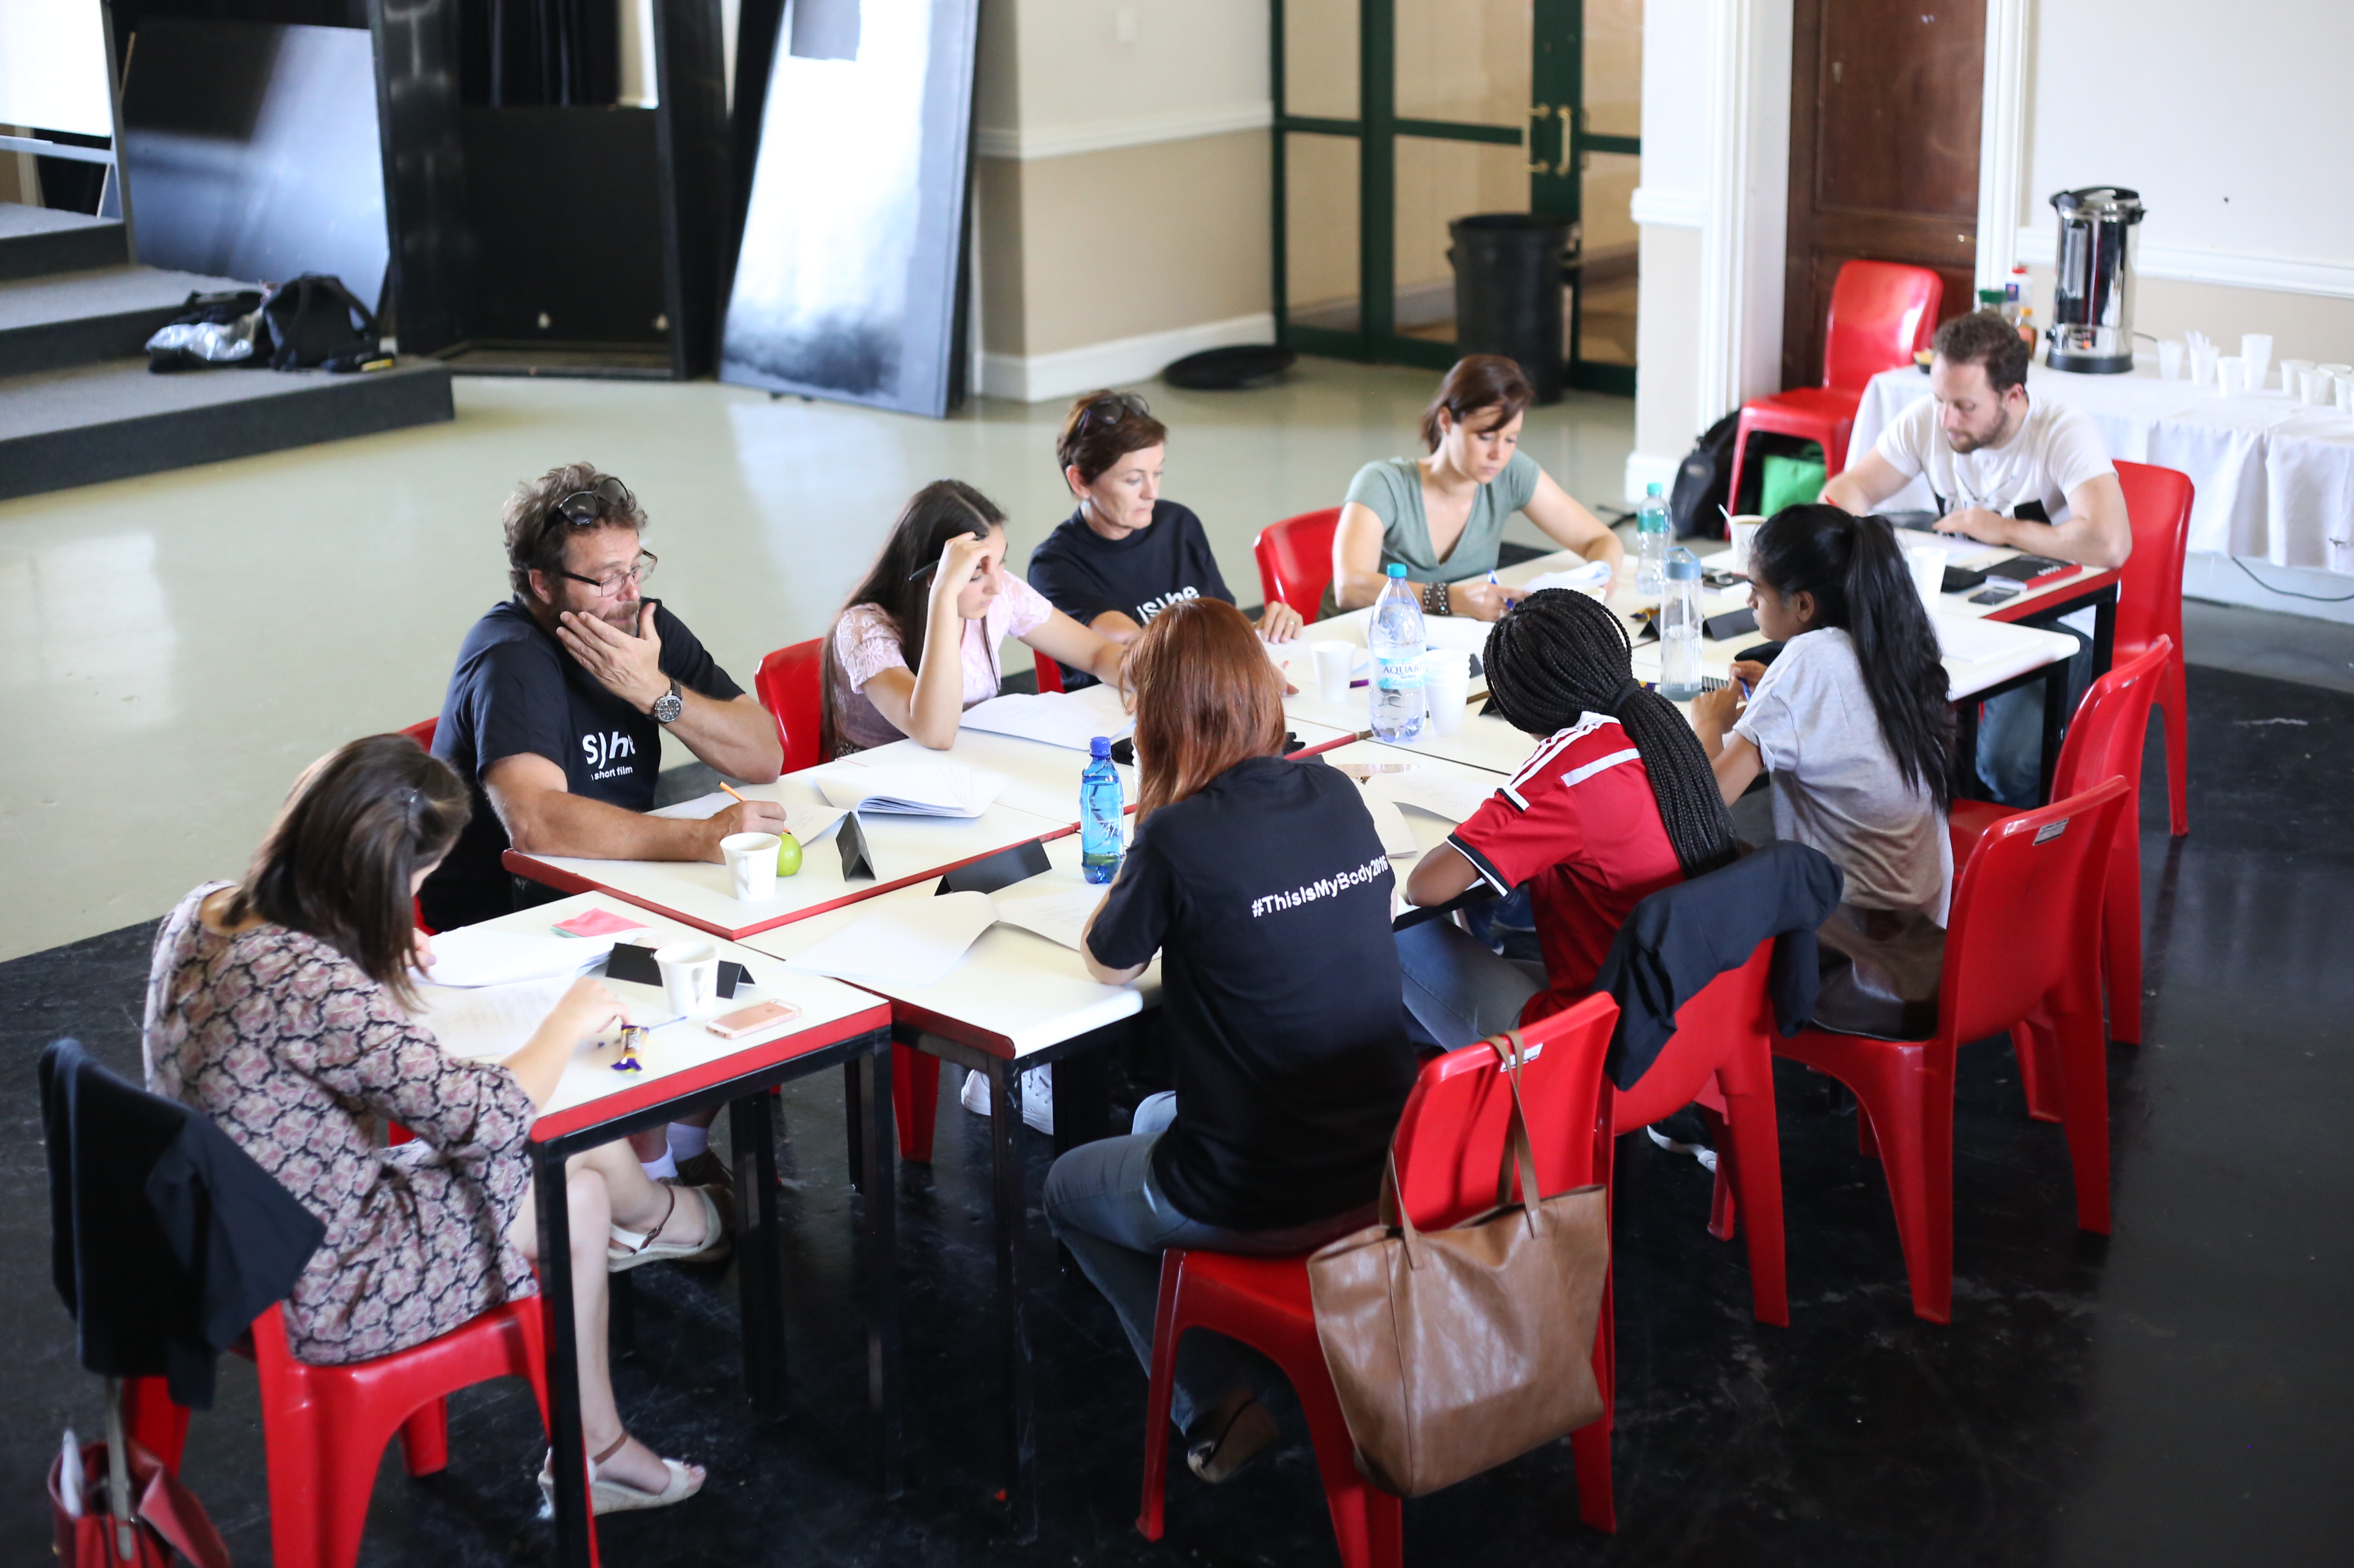
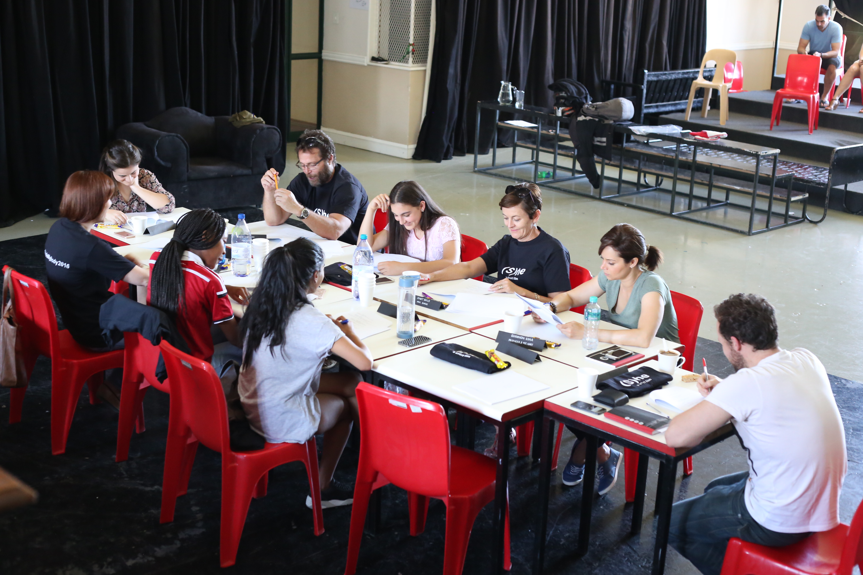
Table Read: Images
In order to get a better sense of how the script read, I organized a live table read with the entire cast. Below are images and video clips from the table read:

Slide 11
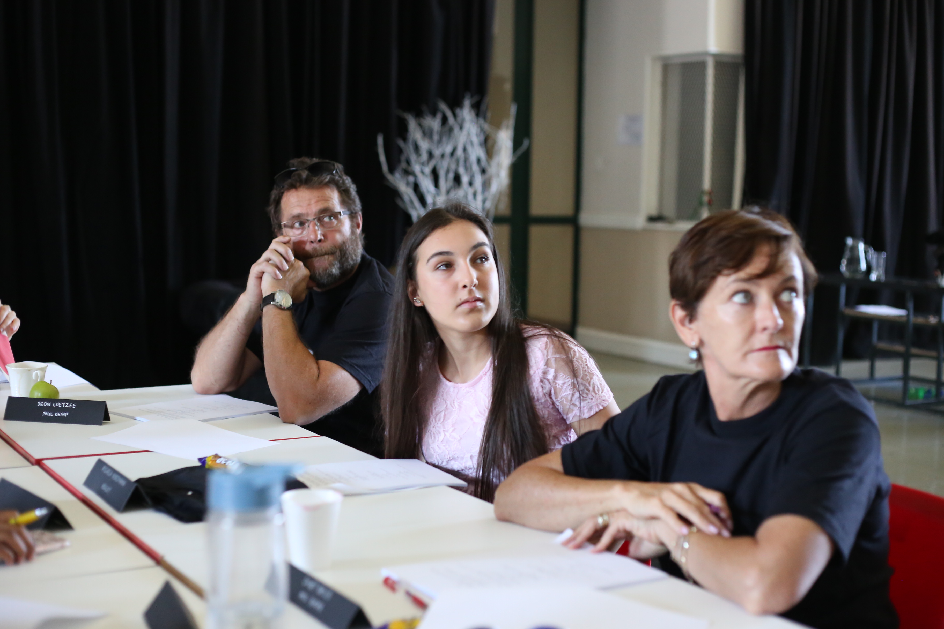
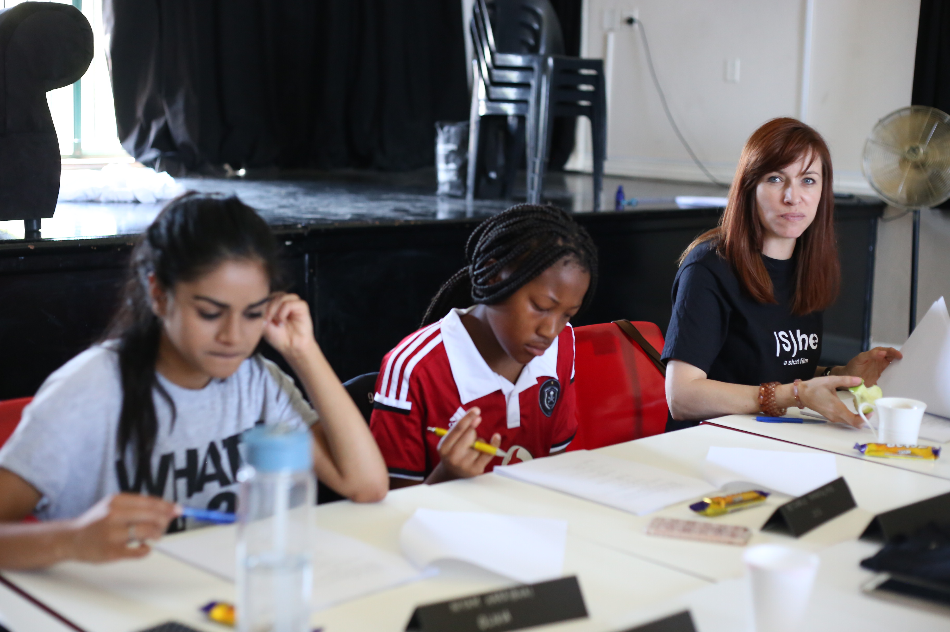
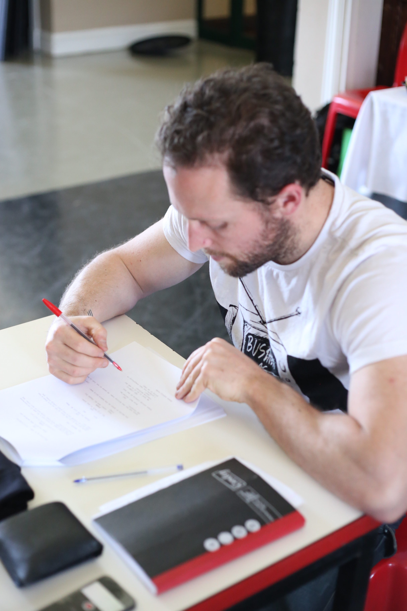
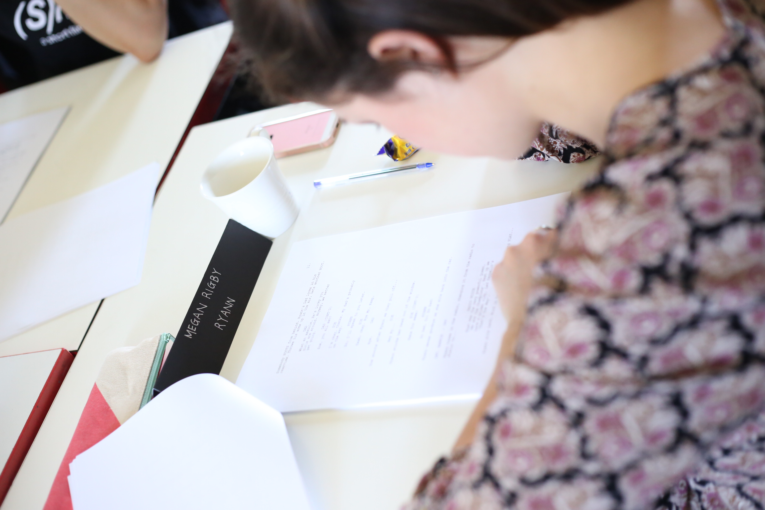
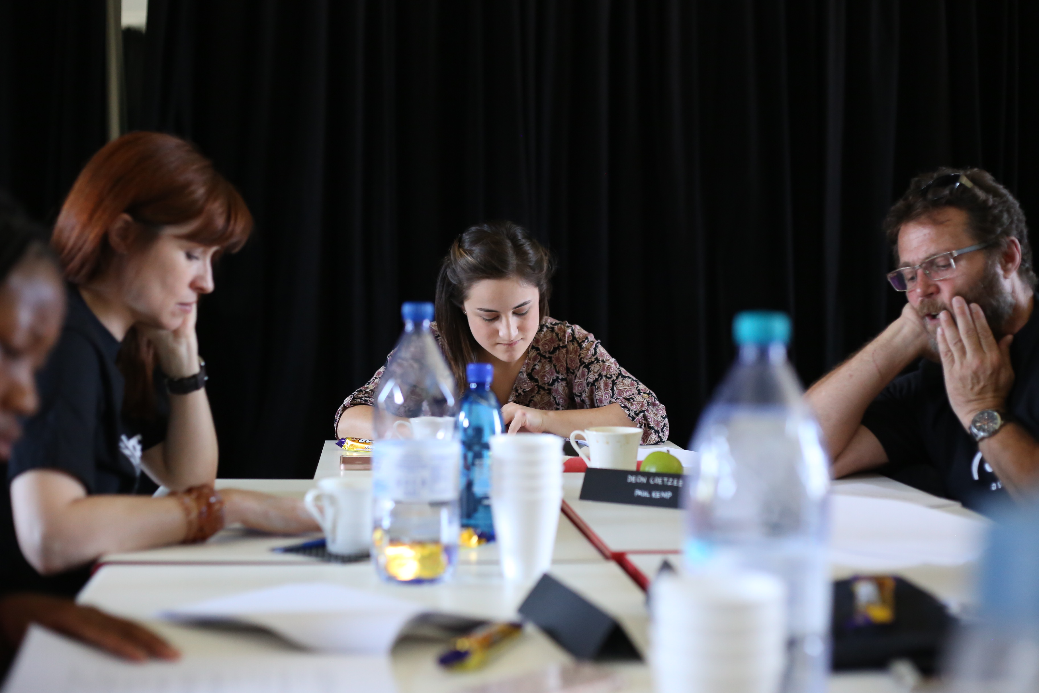
Table Read: Images

Slide 12
Table Read: Video Clips
PLEASE SEE THE VIDEO FILE – 2. TABLE READ

Slide 13
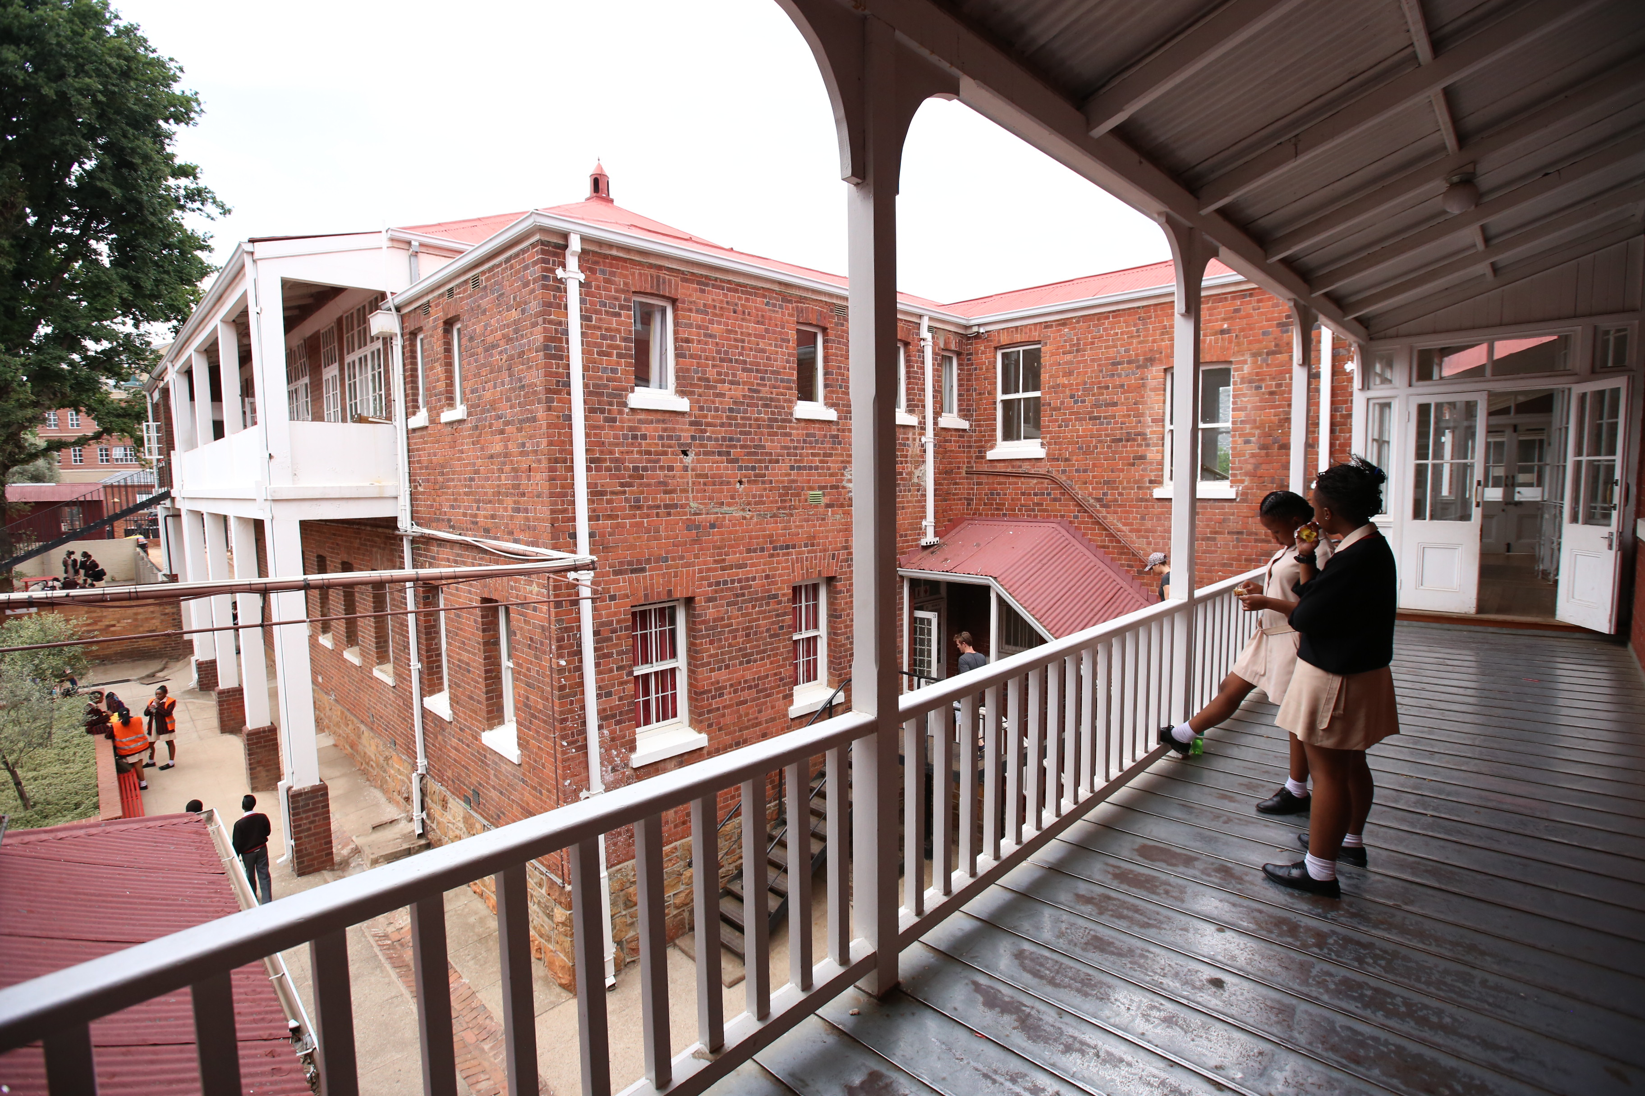
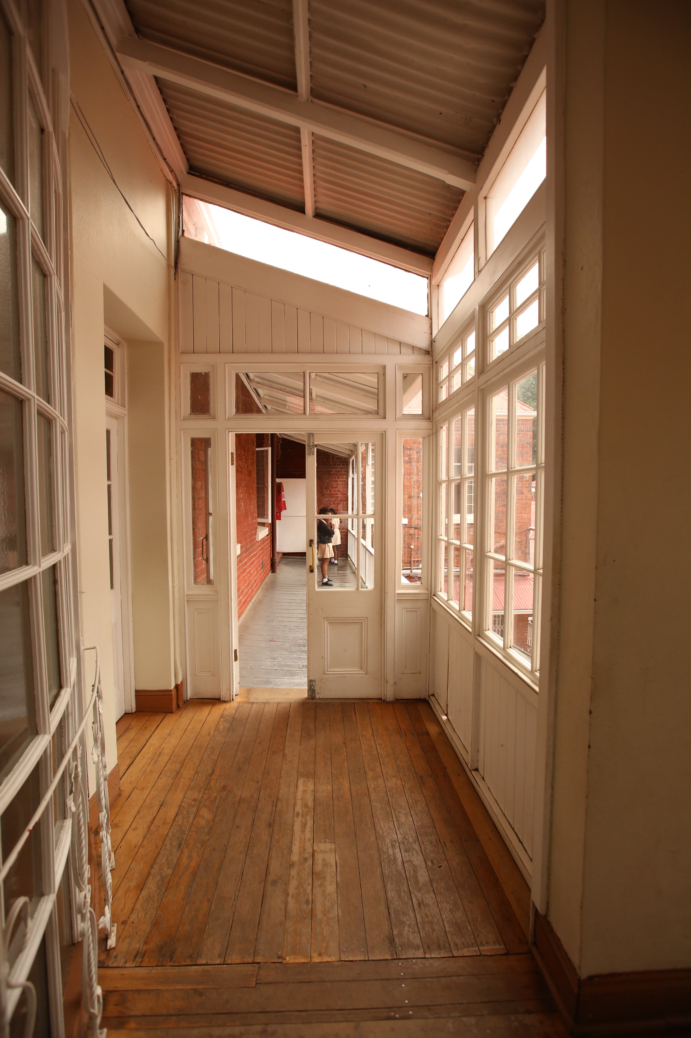
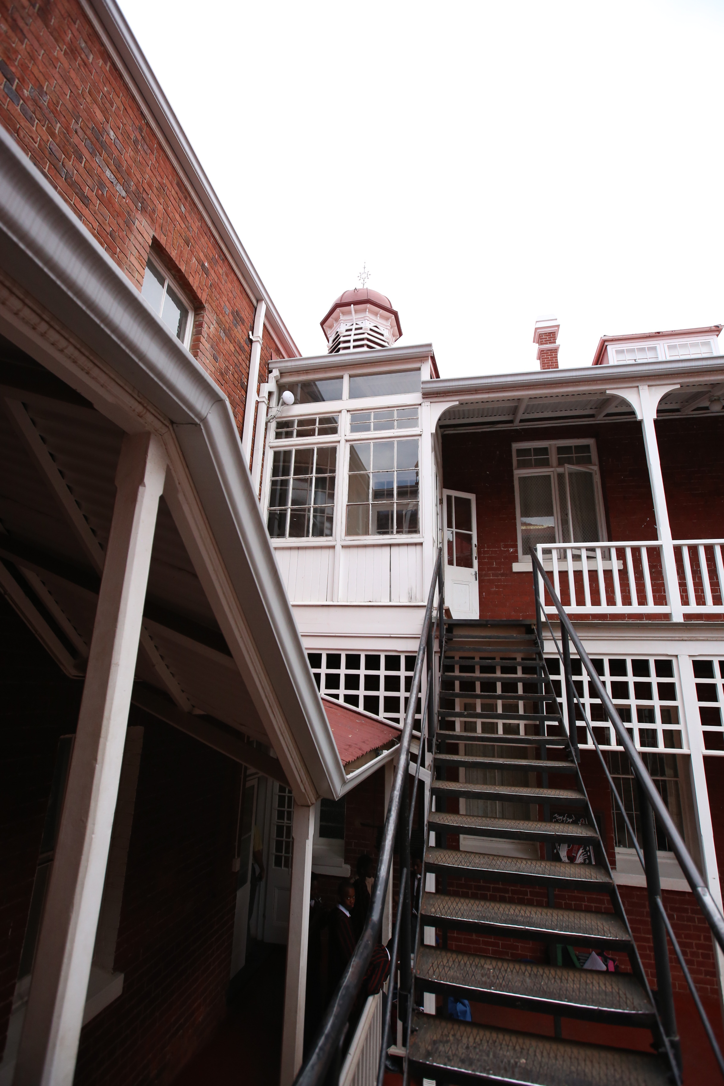
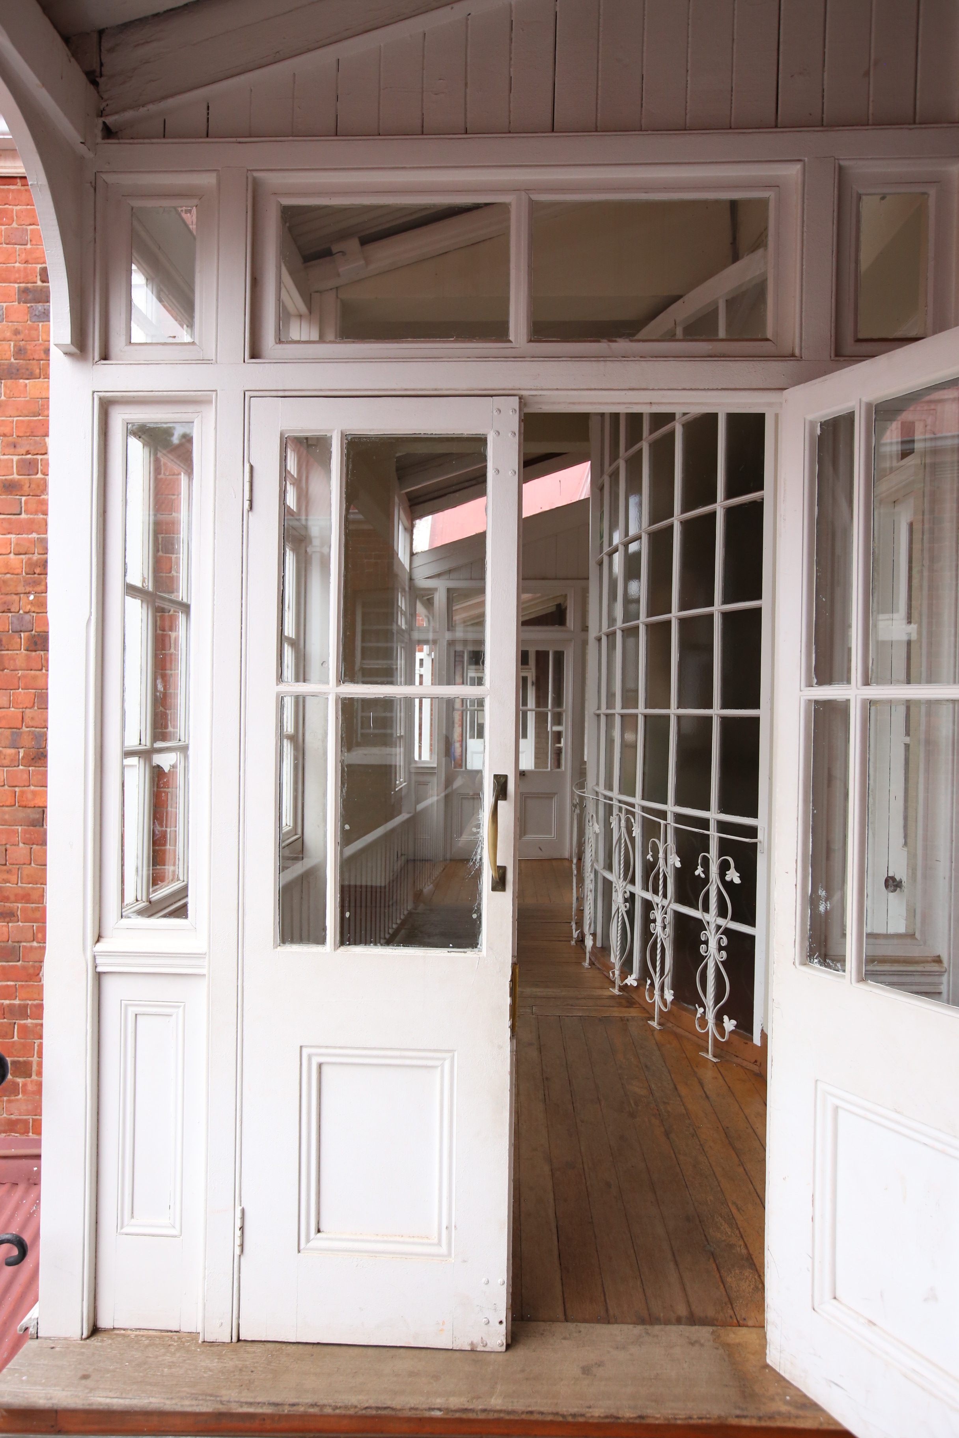
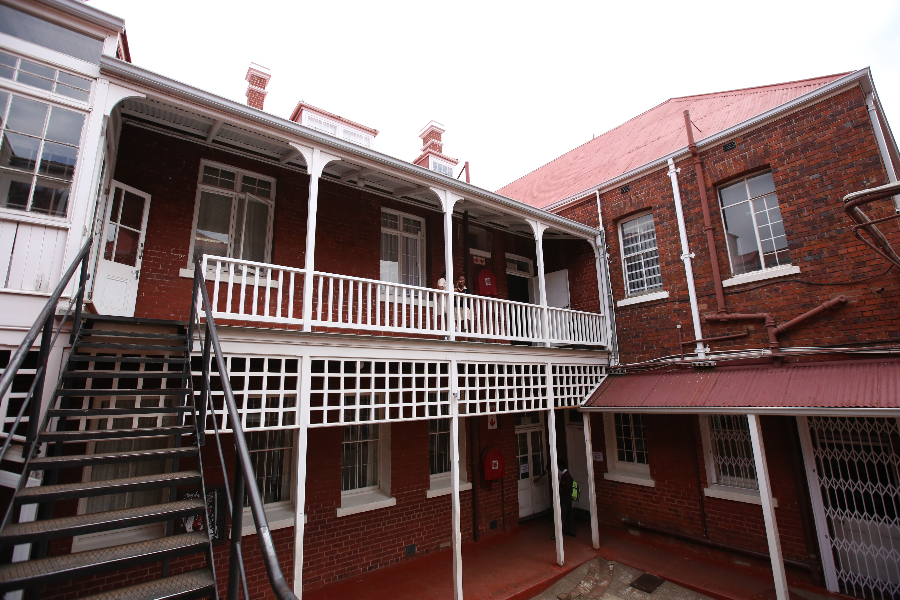
Location 1 – School
SCENE 11

Slide 14
Floor Plans: Location 1 - Blocking and Staging
SCENE 11 (part 1) - 1 Set-Up
S
MS
S-1
Z
A
F
F
R
F
F
Character Key:
R – Ryann
Z – Zoe
S – Shey
Camera Key:
MS – Medium Shot
MCU – Medium Close-Up
OTS – Over the Shoulder
S-1, S-2 etc: – Set-up 1, Set-up 2 etc:
– Camera
– Tracking
A – Ashley
M.B – Mrs. Burke
F - Friends

Slide 15
SCENE 11 (part 2) - 3 Set-Ups
MS to MCU
S
S-1
Z
MCU
S-2
R
S-3
A
F
F
F
F
Character Key:
R – Ryann
Z – Zoe
S – Shey
Camera Key:
MS – Medium Shot
MCU – Medium Close-Up
OTS – Over the Shoulder
S-1, S-2 etc: – Set-up 1, Set-up 2 etc:
– Camera
– Tracking
A – Ashley
M.B – Mrs. Burke
F - Friends

Slide 16
SCENE 11 (part 3) - 5 Set-Ups
S
MCU
MS
R
S-4
Z
S-2
S-1
MCU
MS
A
S-3
S-5
MCU
F
F
F
F
Character Key:
R – Ryann
Z – Zoe
S – Shey
Camera Key:
MS – Medium Shot
MCU – Medium Close-Up
OTS – Over the Shoulder
S-1, S-2 etc: – Set-up 1, Set-up 2 etc:
– Camera
– Tracking
A – Ashley
M.B – Mrs. Burke
F - Friends

Slide 17
SCENE 11 (part 4) - 6 Set-Ups
S
MCU
MS
R
S-4
MCU
Z
S-2
S-1
MCU
S-6
A
M.B
MCU
S-3
S-5
F
MCU
F
F
F
Character Key:
R – Ryann
Z – Zoe
S – Shey
Camera Key:
MS – Medium Shot
MCU – Medium Close-Up
OTS – Over the Shoulder
S-1, S-2 etc: – Set-up 1, Set-up 2 etc:
– Camera
– Tracking
A – Ashley
M.B – Mrs. Burke
F - Friends

Slide 18
SCENE 11 (part 5) - 4 Set-Ups
S
MCU
M.B
R
S-2
S-3
Z
MCU
A
S-1
MCU
F
F
S-4
MCU
F
F
Character Key:
R – Ryann
Z – Zoe
S – Shey
Camera Key:
MS – Medium Shot
MCU – Medium Close-Up
OTS – Over the Shoulder
S-1, S-2 etc: – Set-up 1, Set-up 2 etc:
– Camera
– Tracking
A – Ashley
M.B – Mrs. Burke
F - Friends

Slide 19
SCENE 11 (part 6) - 4 Set-Ups
MCU
A
OTS
MCU
S-3
S-2
S-1
M.B
MCU
S-4
R
Character Key:
R – Ryann
Z – Zoe
S – Shey
Camera Key:
MS – Medium Shot
MCU – Medium Close-Up
OTS – Over the Shoulder
S-1, S-2 etc: – Set-up 1, Set-up 2 etc:
– Camera
– Tracking
A – Ashley
M.B – Mrs. Burke
F - Friends

Slide 20
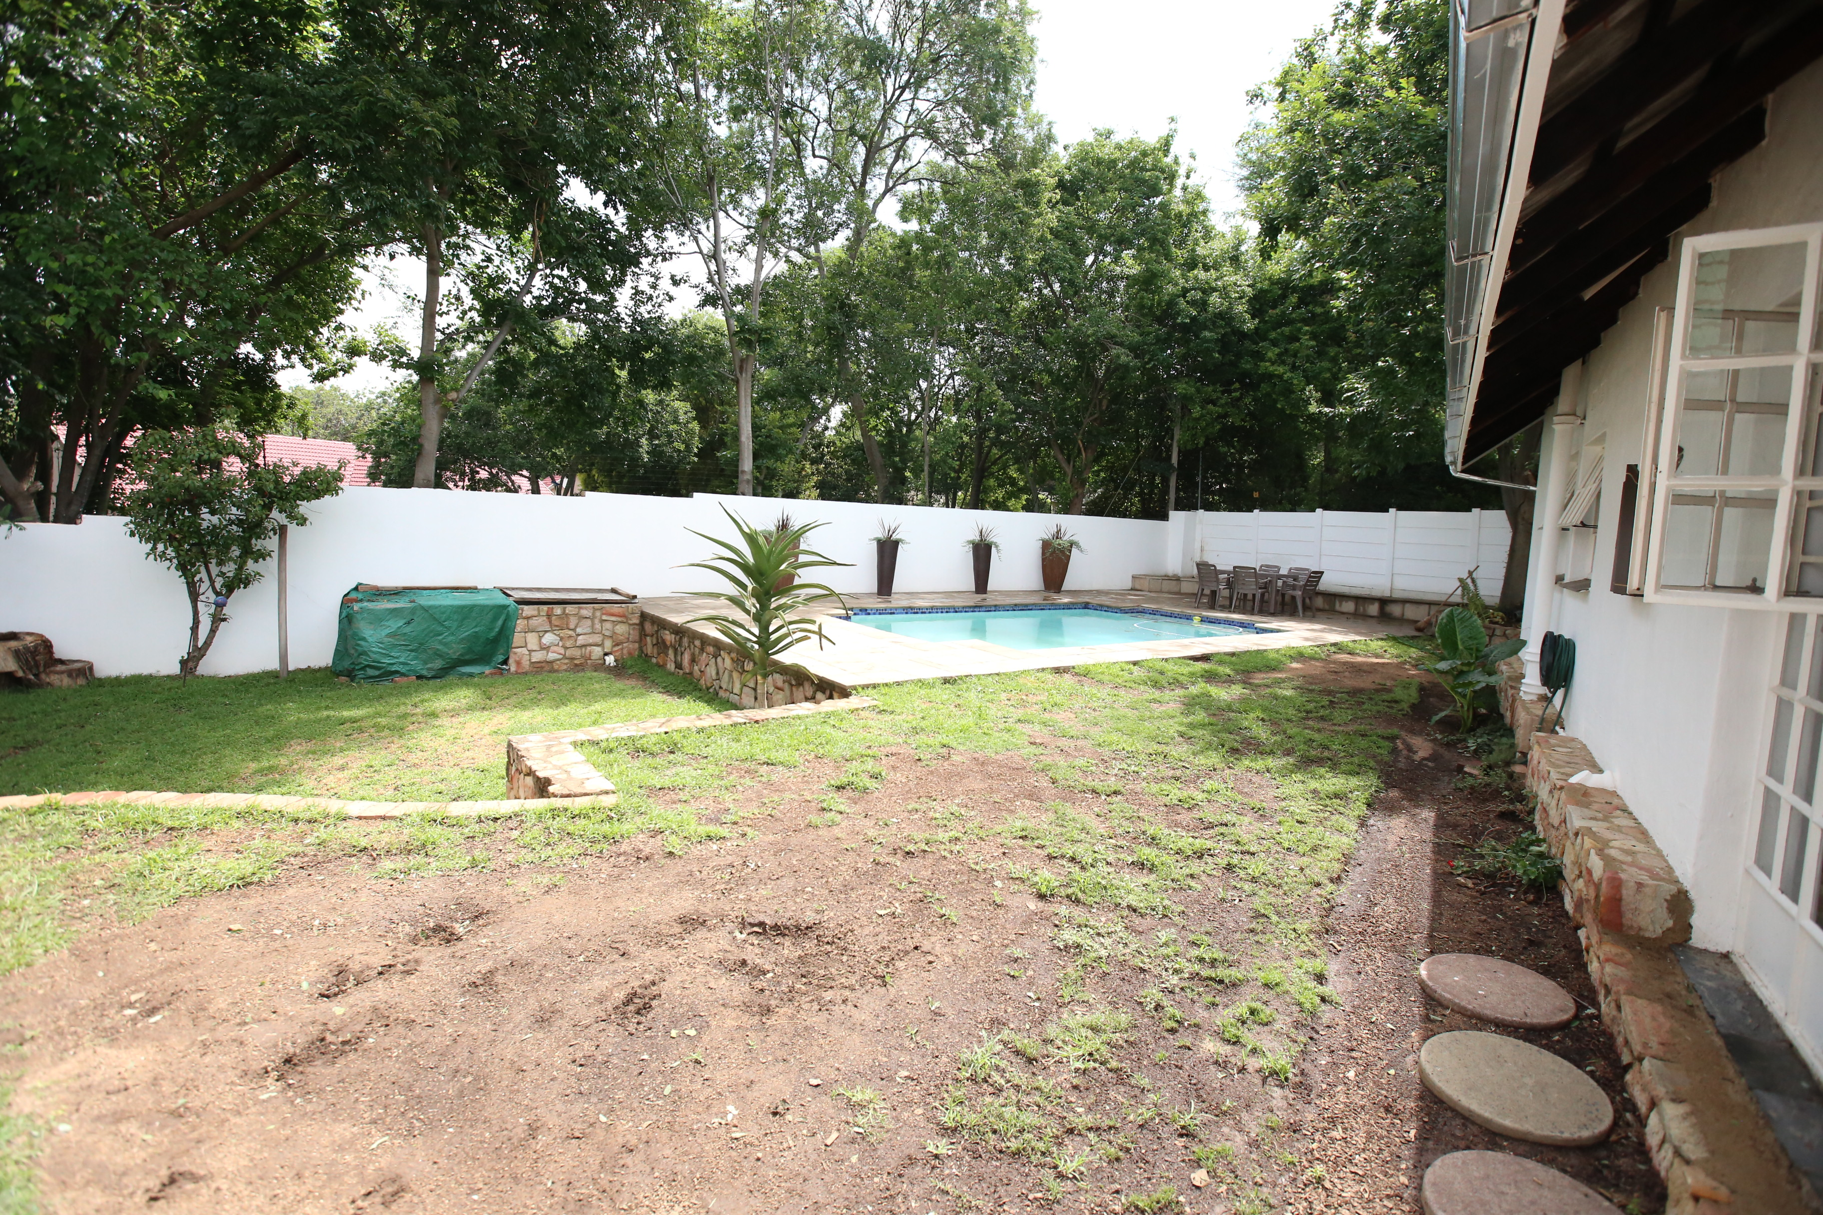
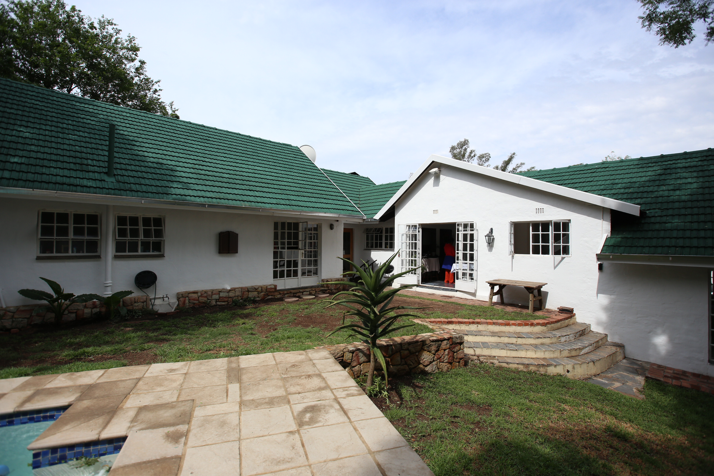
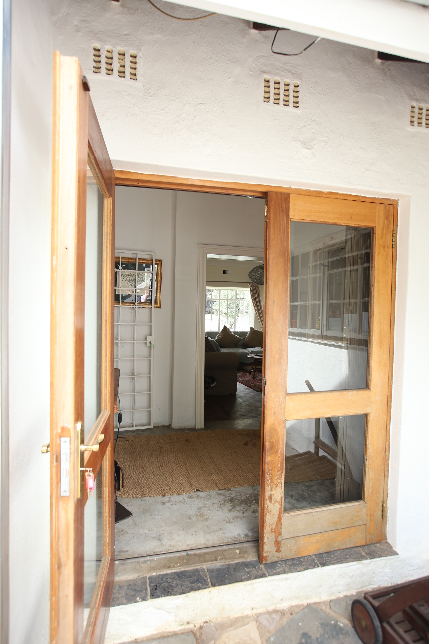
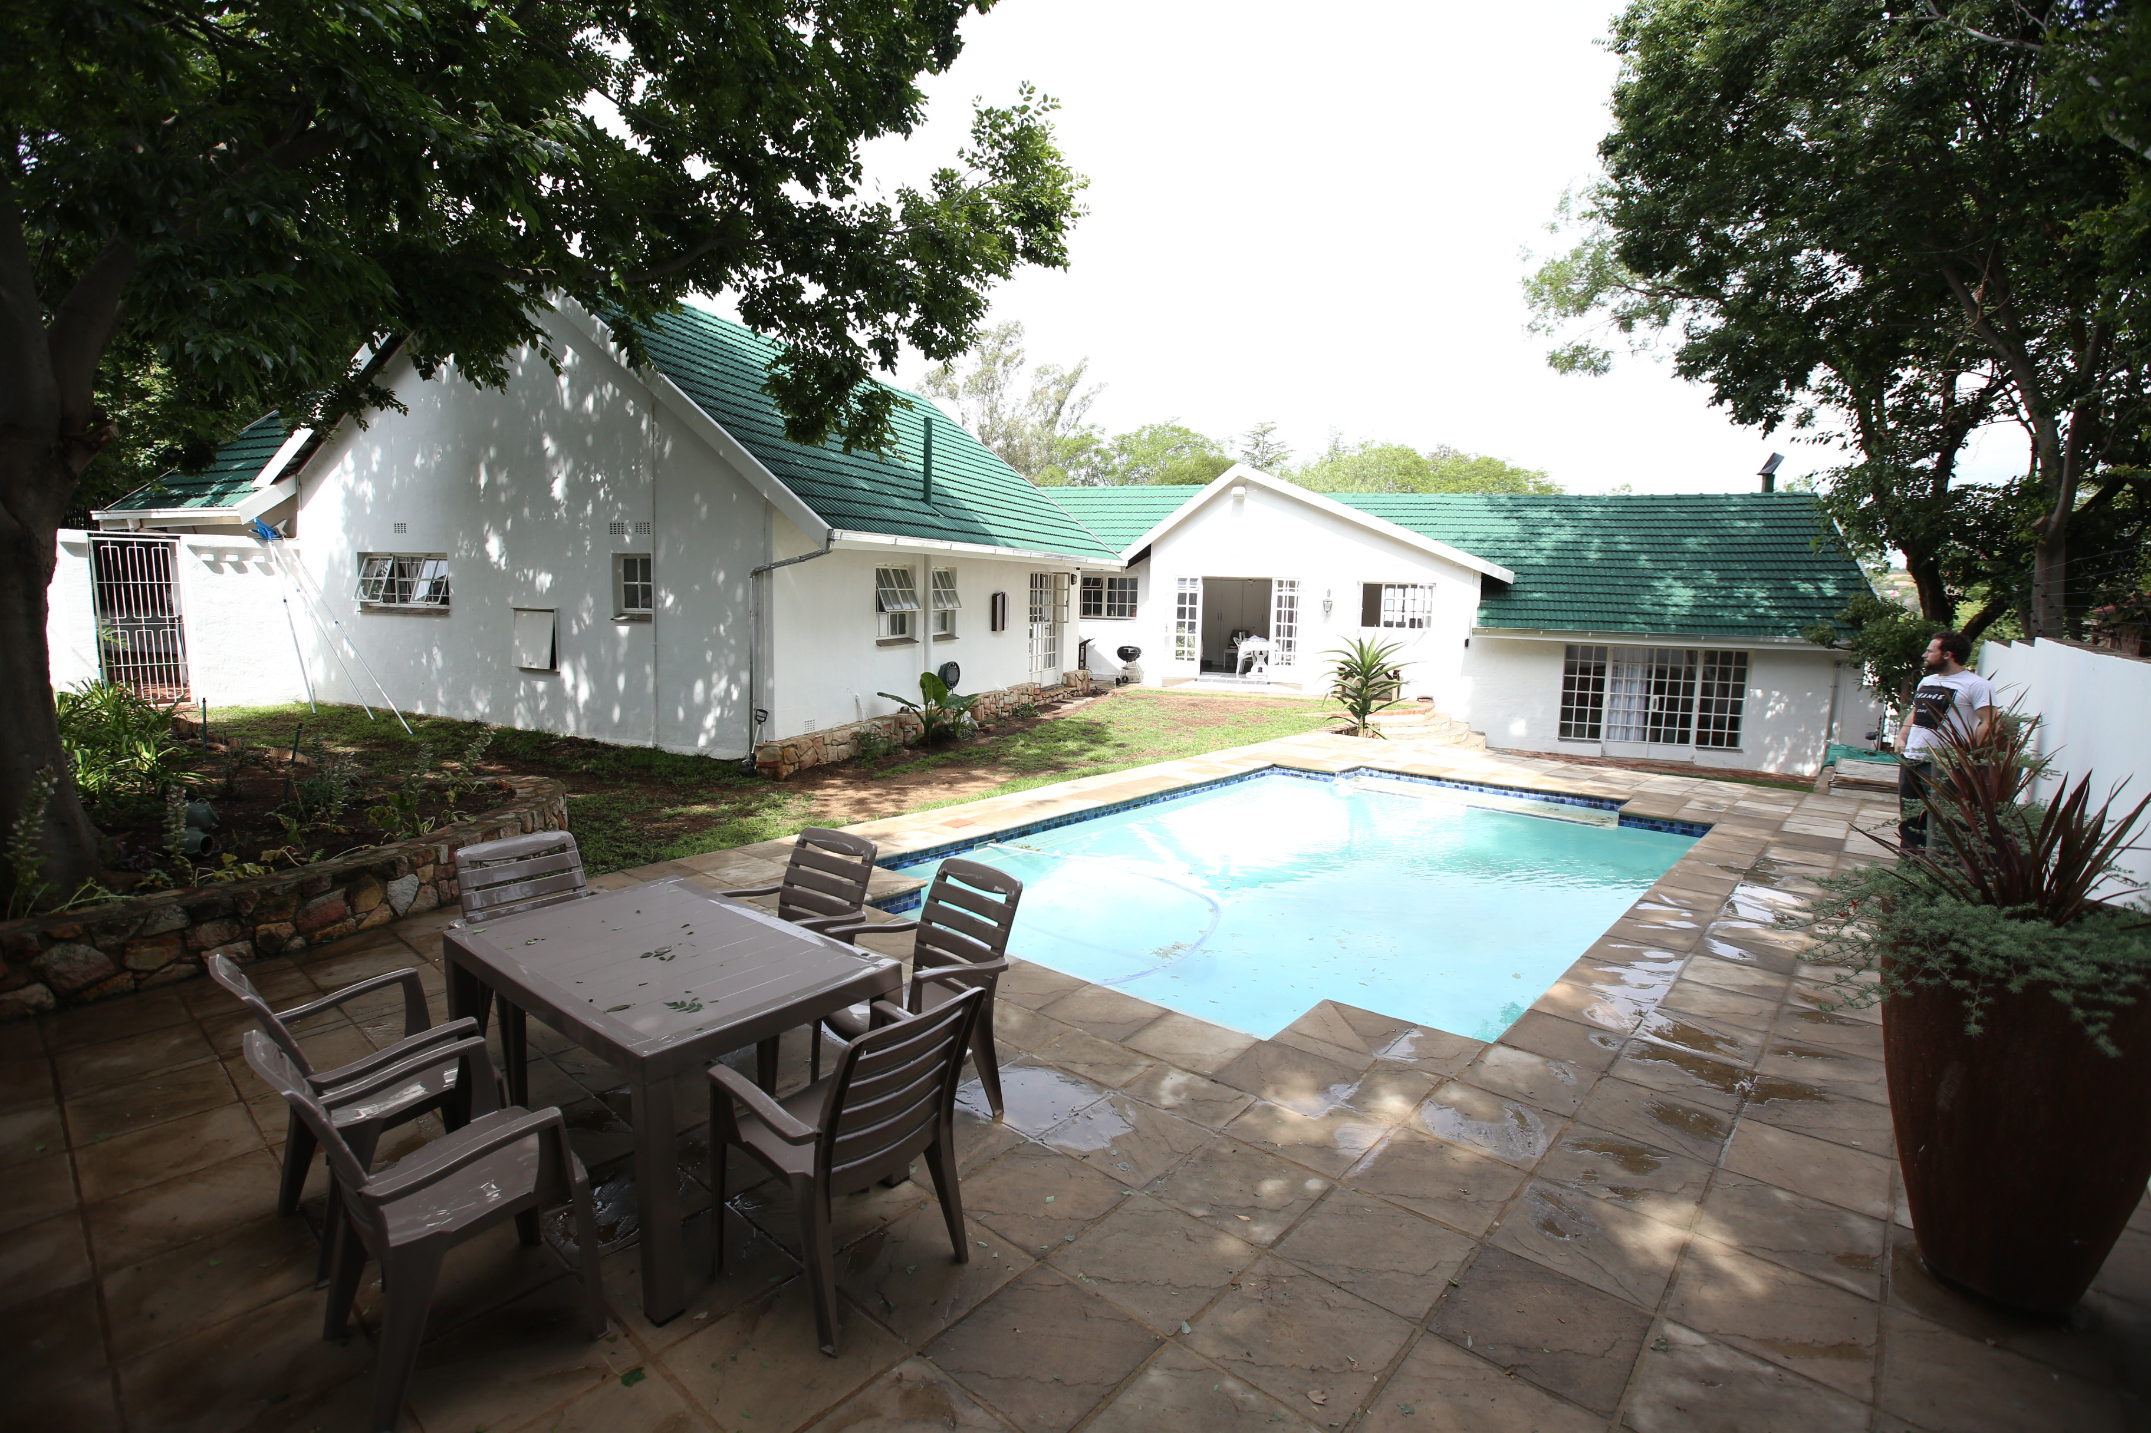
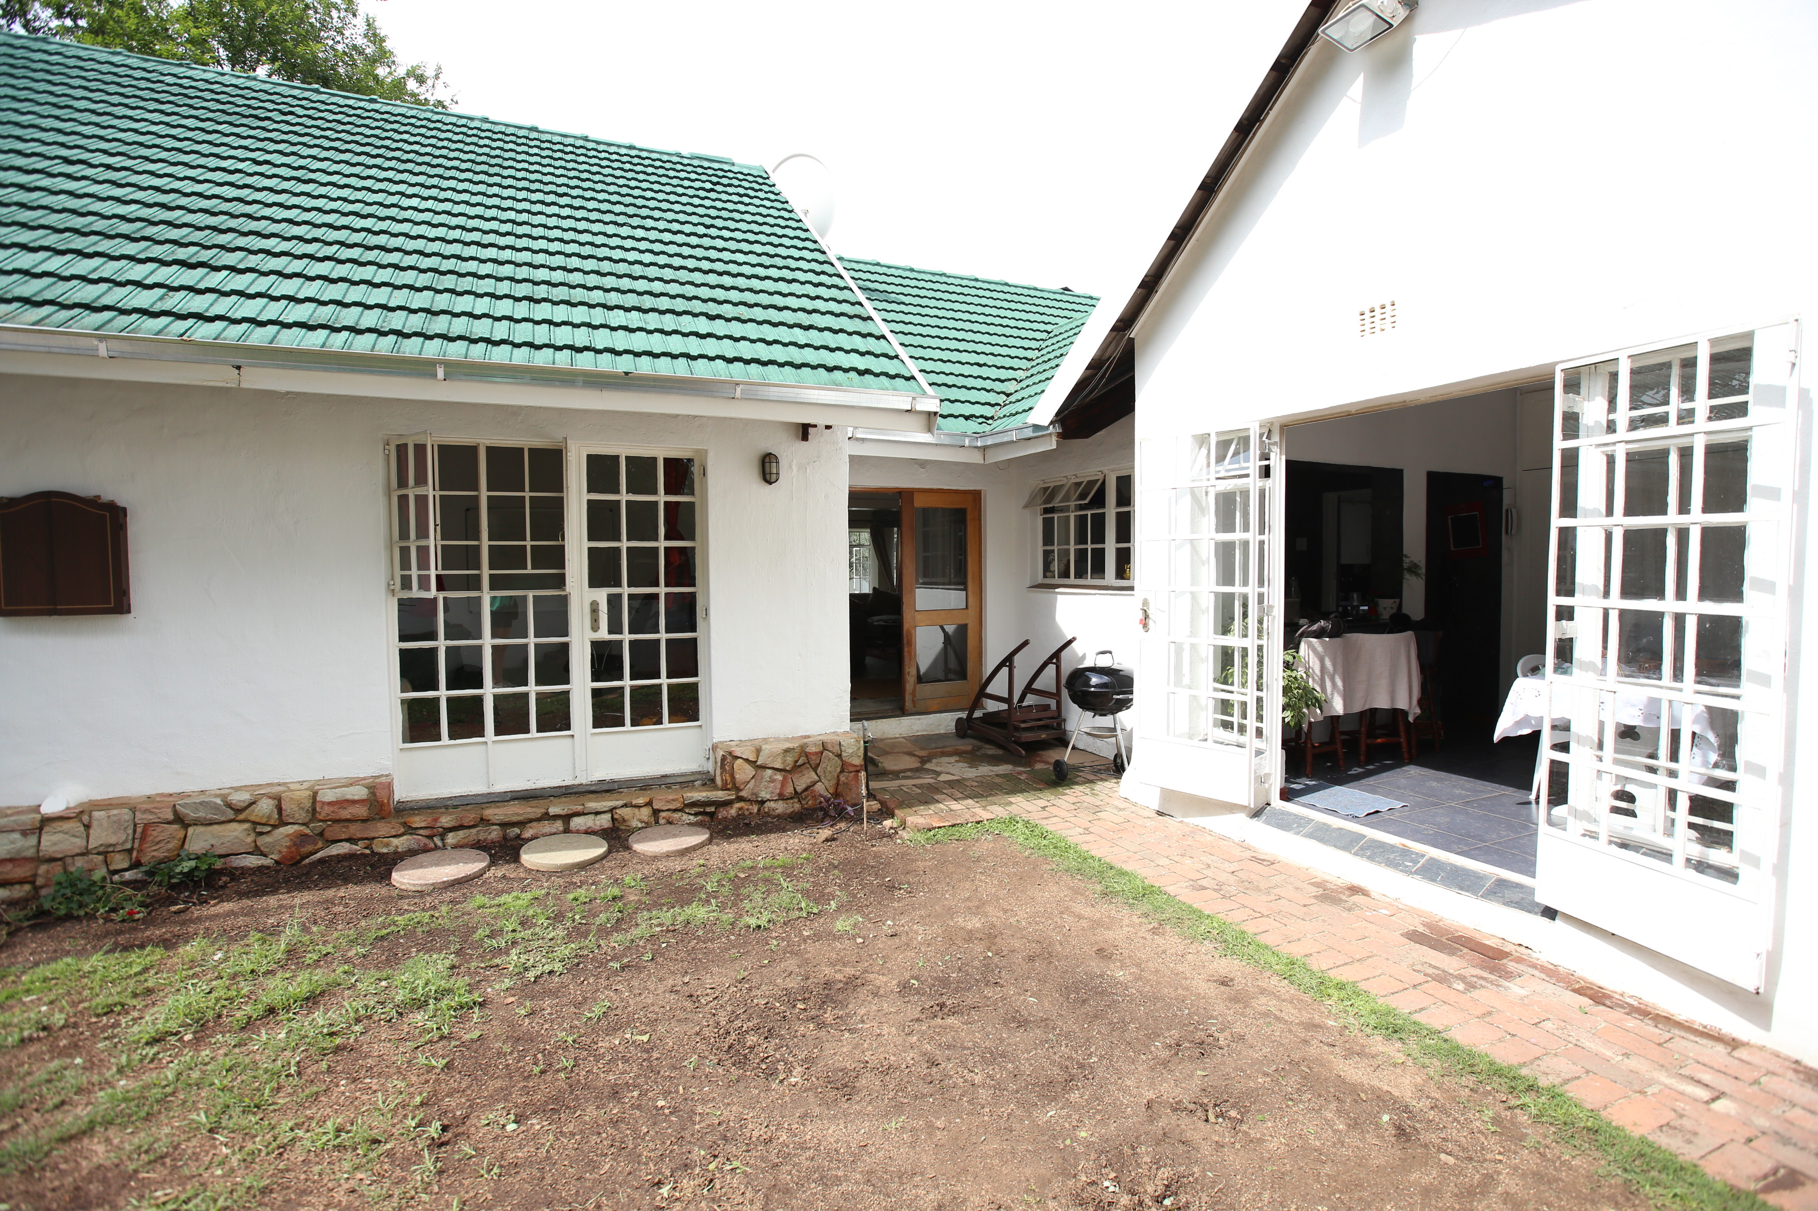
Location 2 – Ryann’s house (outside)
SCENE 15

Slide 21
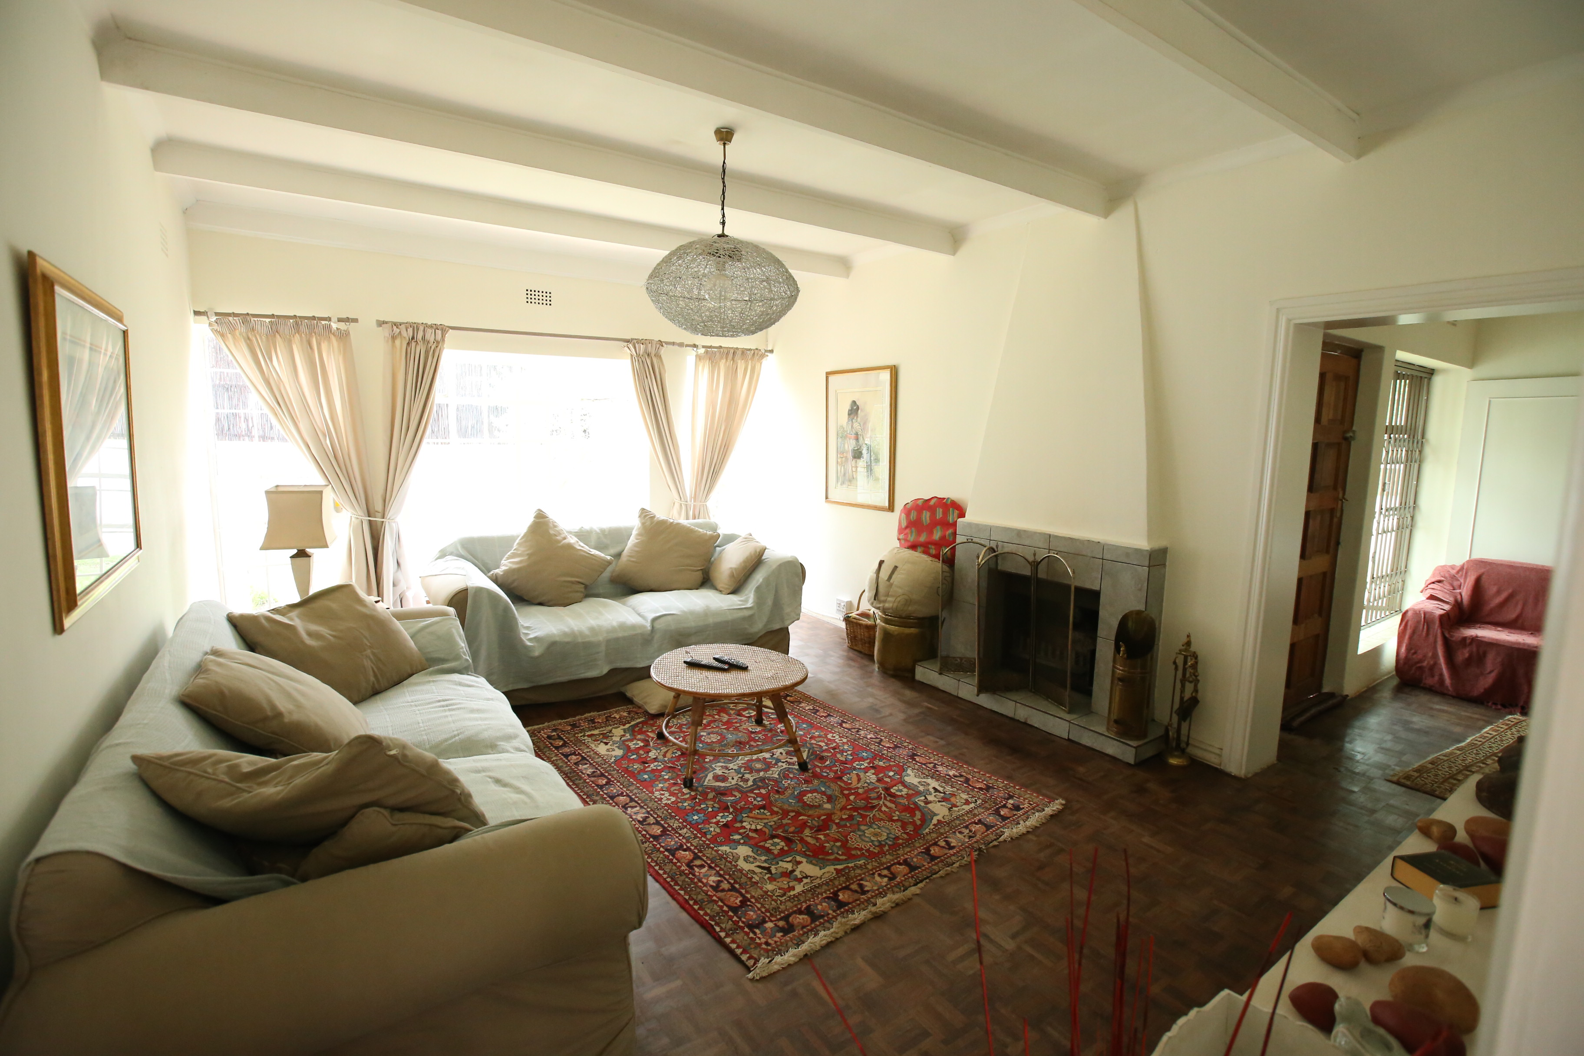
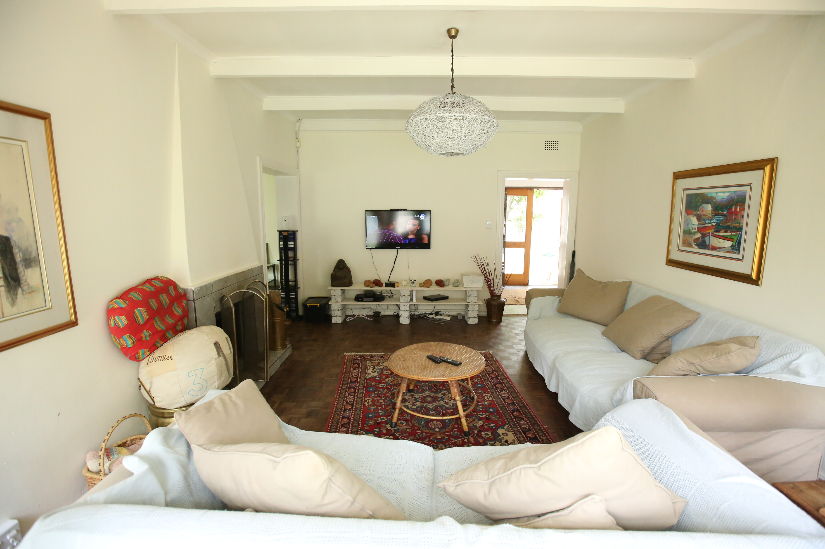
Location 2 – Ryann’s house (Inside)
SCENE 15

Slide 22
Floor Plans: Location 2 - Blocking and Staging
SCENE 15 (part 1) - 2 Set-Ups
Character Key:
R – Ryann
M – Maree
P – Paul
Lounge
Camera Key:
MS – Medium Shot
MCU – Medium Close-Up
OTS – Over the Shoulder
S-1, S-2 etc: – Set-up 1, Set-up 2 etc:
– Camera
– Tracking
M
P
S-1
MS
S-1
R
S-2
MS to MCU
Pool

Slide 23
SCENE 15 (part 2) - 2 Set-Ups
Character Key:
R – Ryann
M – Maree
P – Paul
Lounge
Camera Key:
MS – Medium Shot
MCU – Medium Close-Up
OTS – Over the Shoulder
S-1, S-2 etc: – Set-up 1, Set-up 2 etc:
– Camera
– Tracking
M
P
MS to MCU
S-1
R
S-2
MCU
Pool

Slide 24
SCENE 15 (part 3) - 5 Set-Ups
Character Key:
R – Ryann
M – Maree
P – Paul
Lounge
Camera Key:
MS – Medium Shot
MCU – Medium Close-Up
OTS – Over the Shoulder
S-1, S-2 etc: – Set-up 1, Set-up 2 etc:
– Camera
– Tracking
M
MCU
P
S-4
MCU
S-5
S-3
MS
R
S-1
MCU
S-2
OTS
Pool

Slide 25
SCENE 15 (part 4) - 6 Set-Ups
Character Key:
R – Ryann
M – Maree
P – Paul
OTS
Lounge
Camera Key:
MS – Medium Shot
MCU – Medium Close-Up
OTS – Over the Shoulder
S-1, S-2 etc: – Set-up 1, Set-up 2 etc:
– Camera
– Tracking
S-4
M
MCU
P
S-2
MCU
S-3
S-1
MS
MCU
S-6
R
S-5
OTS
Pool

Slide 26
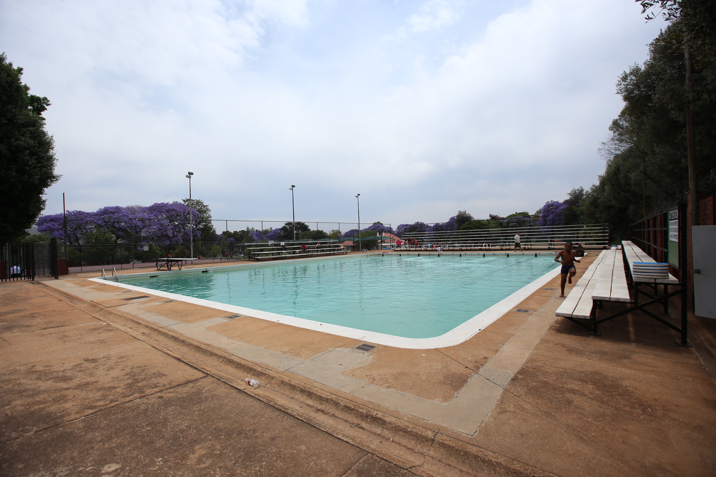
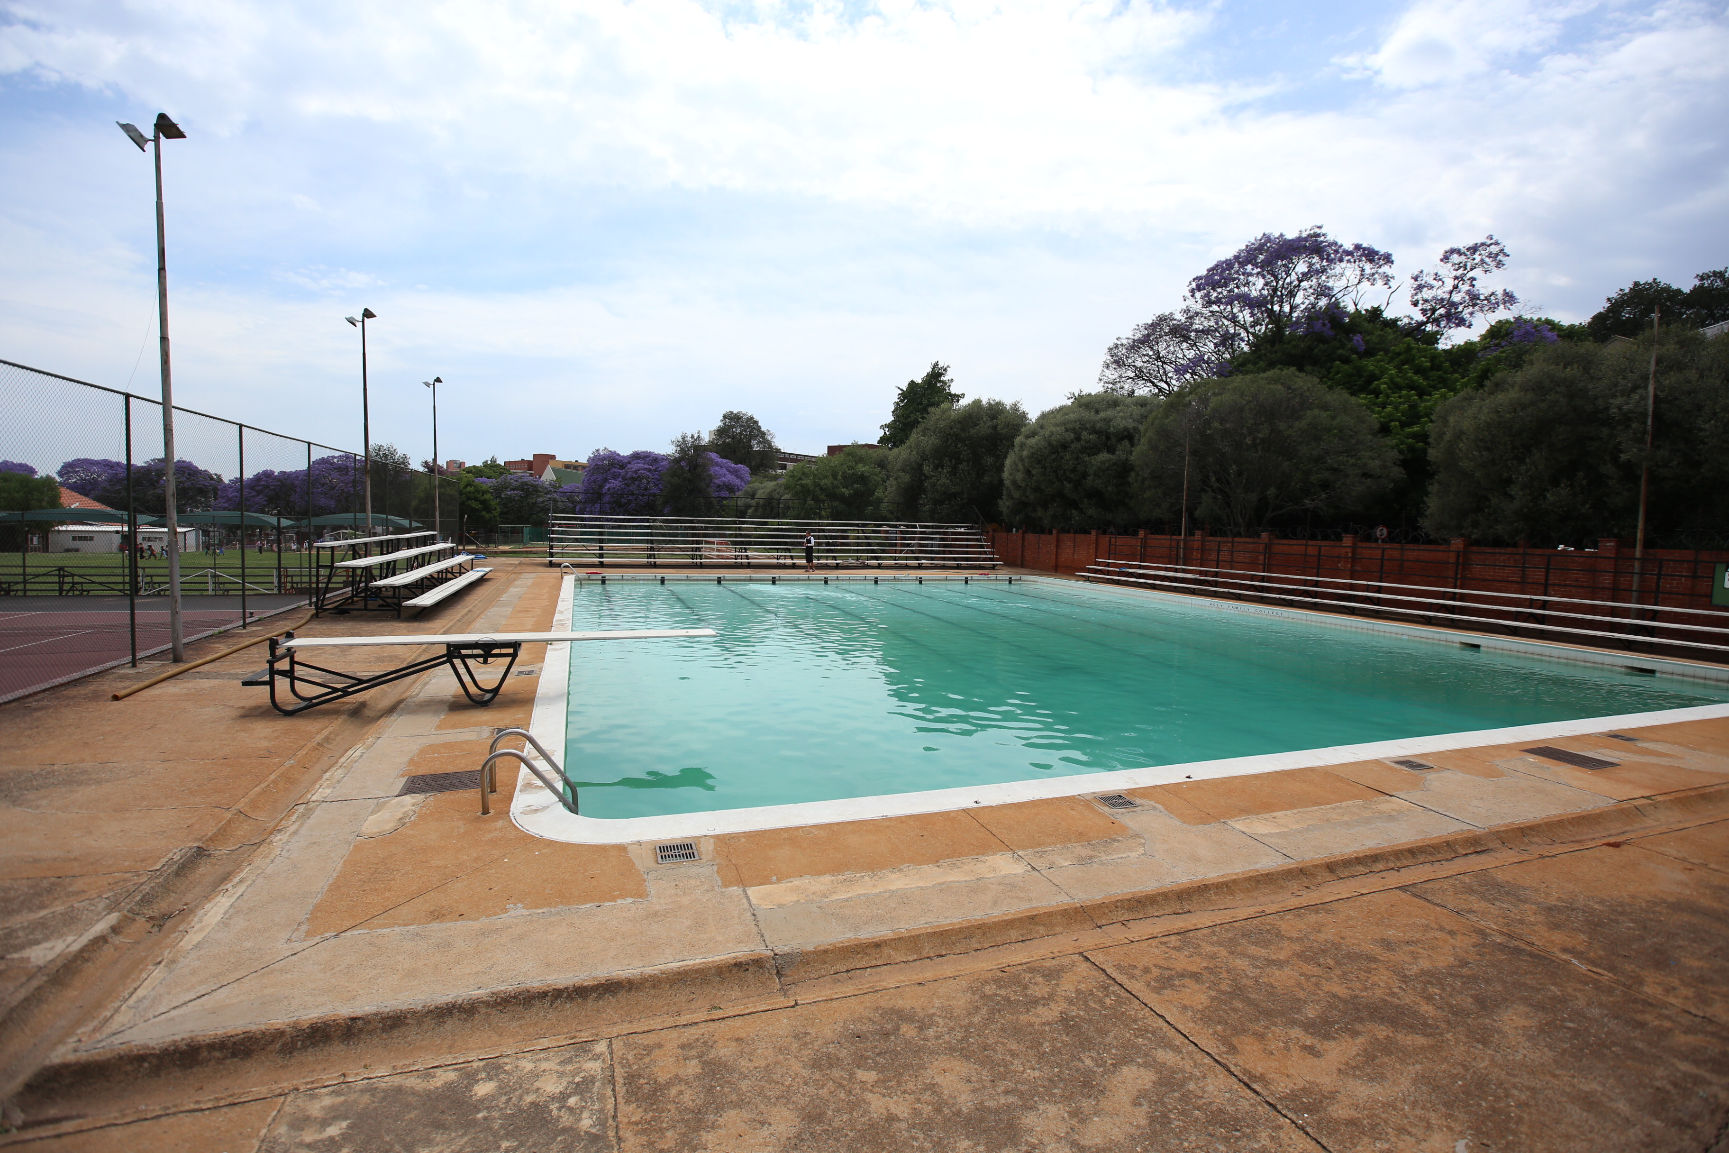
Location 3 – Swimming Pool
SCENE 26

Slide 27
Floor Plans: Location 3 - Blocking and Staging
SCENE 26 (part 1) - 9 Set-Ups
C
Stands
Character Key:
R – Ryann
Z – Zoe
S – Shey
A – Ashley
M.H – Miss Hart
M.B – Mrs. Burke
F – Friends
SW - Swimmers
C – Crowd
M.B
MS
Camera Key:
MS – Medium Shot
MCU – Medium Close-Up
OTS – Over the Shoulder
S-1, S-2 etc: – Set-up 1, Set-up 2 etc:
– Camera
– Tracking
MCU
S-4
S-3
SW
SW
A
SW
MCU
S-9
SW
M.HS
Pool
MCU
MS
Diving Board
S-8
MCU
C
MS to MCU
S-7
S-6
S-5
MS
C
MS
Z
R
S
S-2
S-1
C

Slide 28
SCENE 26 (part 2) - 7 Set-Ups
C
MS
Stands
Character Key:
R – Ryann
Z – Zoe
S – Shey
A – Ashley
M.H – Miss Hart
M.B – Mrs. Burke
F – Friends
SW - Swimmers
C – Crowd
S-2
F
M.B
MS
Camera Key:
MS – Medium Shot
MCU – Medium Close-Up
OTS – Over the Shoulder
S-1, S-2 etc: – Set-up 1, Set-up 2 etc:
– Camera
– Tracking
S-1
MS
F
S-3
A
M.H
Pool
MS
Diving Board
S-4
MCU
Z
S-6
C
MCU
C
S-5
R
S
S-7
C
MCU

Slide 29
SCENE 26 (part 3) - 5 Set-Ups
C
Stands
Character Key:
R – Ryann
Z – Zoe
S – Shey
A – Ashley
M.H – Miss Hart
M.B – Mrs. Burke
F – Friends
SW - Swimmers
C – Crowd
Camera Key:
MS – Medium Shot
MCU – Medium Close-Up
OTS – Over the Shoulder
S-1, S-2 etc: – Set-up 1, Set-up 2 etc:
– Camera
– Tracking
MCU
A
S-1
F
S-2
MCU
F
Z
S-3
MCU
M.H
Pool
Diving Board
S-4
MCU
C
MCU
C
S-5
S
R
C

Slide 30
SCENE 26 (part 4) - 7 Set-Ups
C
Stands
Character Key:
R – Ryann
Z – Zoe
S – Shey
A – Ashley
M.H – Miss Hart
M.B – Mrs. Burke
F – Friends
SW - Swimmers
C – Crowd
S-3
MCU
Camera Key:
MS – Medium Shot
MCU – Medium Close-Up
OTS – Over the Shoulder
S-1, S-2 etc: – Set-up 1, Set-up 2 etc:
– Camera
– Tracking
M.B
A
F
MCU
S-1
F
Z
MCU
S-2
S-4
MCU
M.H
Pool
MCU
Diving Board
S-5
C
C
MCU
S-7
S-6
R
S
MS
C

Slide 31
SCENE 26 (part 5) - 7 Set-Ups
C
Stands
Character Key:
R – Ryann
Z – Zoe
S – Shey
A – Ashley
M.H – Miss Hart
M.B – Mrs. Burke
F – Friends
SW - Swimmers
C – Crowd
M.B
Camera Key:
MS – Medium Shot
MCU – Medium Close-Up
OTS – Over the Shoulder
S-1, S-2 etc: – Set-up 1, Set-up 2 etc:
– Camera
– Tracking
S-1
MCU
A
F
MCU
S-2
MS to MCU
F
S-7
Z
S-3
MCU
M.H
R
Pool
Diving Board
S-4
S-5
MCU
C
C
MCU
MCU
S-6
S
C

Slide 32
SCENE 26 (part 6) - 6 Set-Ups
C
Stands
Character Key:
R – Ryann
Z – Zoe
S – Shey
A – Ashley
M.H – Miss Hart
M.B – Mrs. Burke
F – Friends
SW - Swimmers
C – Crowd
M.B
Camera Key:
MS – Medium Shot
MCU – Medium Close-Up
OTS – Over the Shoulder
S-1, S-2 etc: – Set-up 1, Set-up 2 etc:
– Camera
– Tracking
S-1
MCU
A
S-2
MCU
F
MCU
F
S-6
Z
S-3
R
MCU
Pool
S-4
MCU
Diving Board
C
M.H
MCU
C
S-5
S
C

Slide 33
Art Direction
The narrative has two main locations; Ryann’s house and school. In relation to Ryann’s house, the setting should be neutral and not identifiable in terms of its socio-economic level. Whilst the house is the context in which Ryann and her family live, it does not define them. The same goes for Ryann’s school.
It is also important to bear in mind that neither the house nor the school will ever be seen in their entireties or in a particularly wide shot as I do not feel that it will move the story forward in anyway. This is an intimate story where everything needs to feel real. As such, most of the shots will comprise of medium shots and close-ups.
And in order to explore the emotional arcs of my characters, I’ve opted for a colour palette that makes use of muted colours such as blues, greens, browns and burgundies. I feel the best way to achieve this is through the synchronicity of all the departments including; camera, lighting, locations, hair, make up, and wardrobe. Authenticity is key and as such there must be no visual distractions from the narrative.

Slide 34
Film Colour Palette
Available URL: https://cdn.mensagenscomamor.com/resize/400x225/content/images/int/caixinha_de_reflexao.jpg
Available URL: http://www.crocomag.com/wp-content/uploads/2016/06/Will-Broadhurst-2-of-15.jpg
Available URL: http://68.media.tumblr.com/294b167c3e18234be92be569dcdbe93b/tumblr_o7375jCAZ91r1a5igo1_250.jpg
Available URL: http://www.corrinnejames.com/uploads/4/3/9/1/43912863/screen-shot-2016-09-15-at-5-24-54-pm_orig.png
Available URL: https://throughthewoodsblog.files.wordpress.com/2016/07/image14.jpeg?w=640
Available URL: http://68.media.tumblr.com/916a29bf1467375cef2a8c0ecf8b09f8/tumblr_oazz2sMakP1rnaacxo1_1280.jpg
(Centre Image) Available URL: http://www.ufunk.net/wp-content/uploads/2016/06/drone-photography-gabriel-scanu-23.jpg

Slide 35
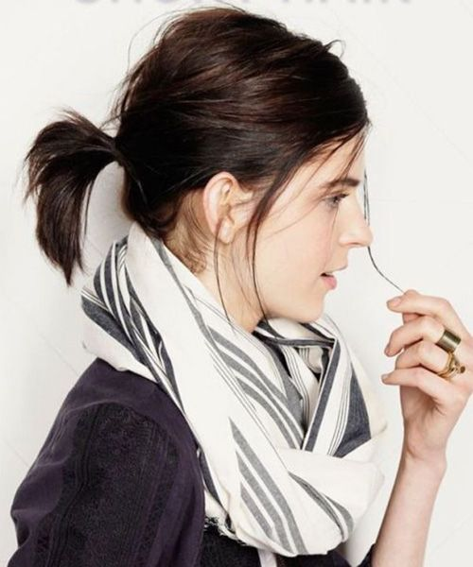
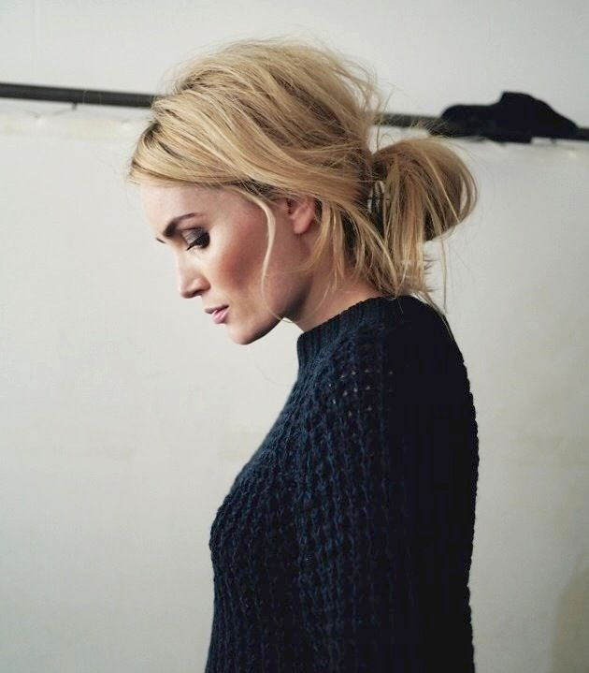
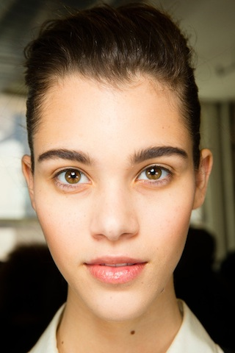
Character Hair and Make-up
Ryann Hair
Available URL: https://s-media-cache-ak0.pinimg.com/736x/fb/8c/9f/fb8c9fe8190d21050980d727b24adf71.jpg
Available URL: https://vespig.files.wordpress.com/2016/09/aaig2jb1_thumb.jpg?w=689&h=689
Ryann Make-up
Available URL: http://p2.pstatp.com/large/2129/3942735350

Slide 36


Ashley Hair
Available URL: https://static1.jeanlouisdavid.com/articles/4/11/94/@/1041-sem17-conseil-cheveuxsante-article_preview-2.jpg
Available URL: https://s-media-cache-ak0.pinimg.com/236x/6a/c8/68/6ac868aef6a91f680e086a5dd6c580ad.jpg
Ashley Make-up
Available URL: http://www.elle.it/bellezza-beauty/corpo/news/g834721/labbra-sos-cure-balsami/

Slide 37
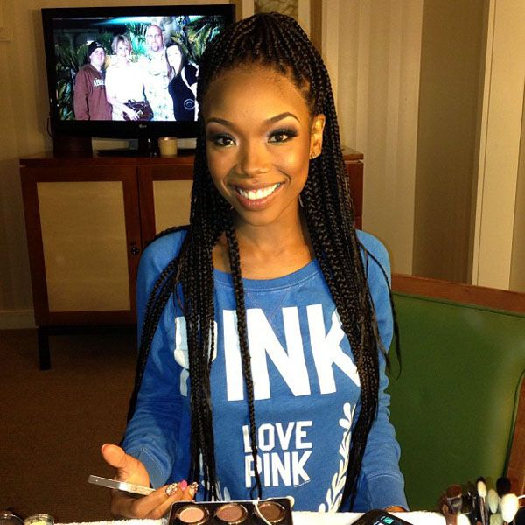
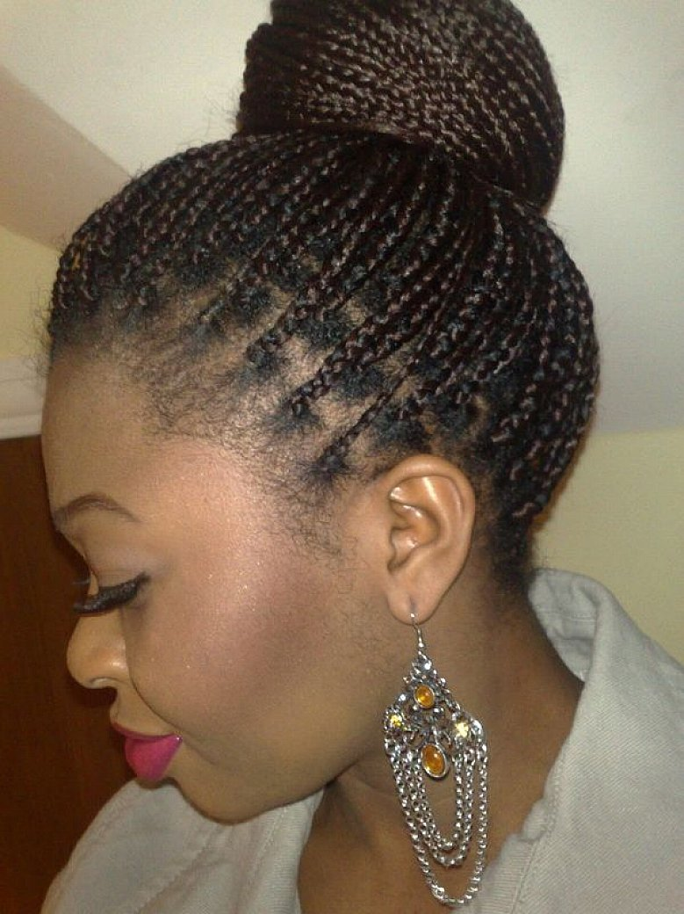
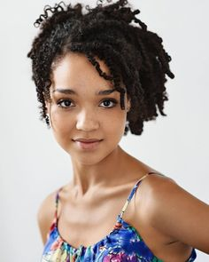
Zoe Hair
Available URL: https://s-media-cache-ak0.pinimg.com/736x/58/66/09/5866093af1f7e59263ab519dc4e49314.jpg
Available URL: http://beautifieddesigns.com/wp-content/uploads/2016/04/micro-braids-hairstyles-updos.jpg
Zoe Make-up
Available URL: https://s-media-cache-ak0.pinimg.com/236x/fe/9c/a3/fe9ca3f7ff3b3aba721d3a309143e8ee.jpg

Slide 38
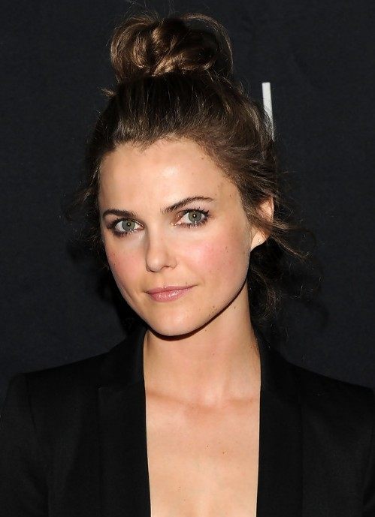
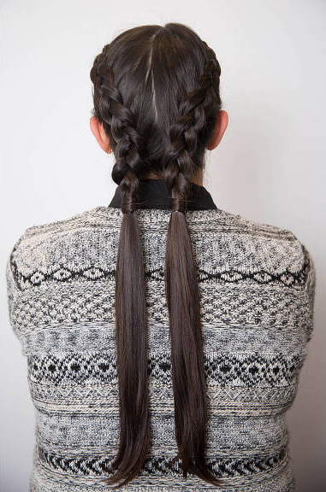
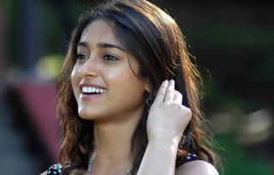
Shey Hair
Available URL: https://s-media-cache-ak0.pinimg.com/236x/50/a5/ed/50a5edfc07ada59dd482edfff9389c3f.jpg
Available URL: https://hips.hearstapps.com/cos.h-cdn.co/assets/14/43/nrm_1414172018-0y3a6740.jpg?crop=1xw:1.0xh;center,top&resize=768:*
Shey Make-up
Available URL: https://recentmovies.in/wp-content/uploads/2016/12/Ileana-Interested-for-Bollywood-Films-Only-1050x550.jpg

Slide 39
Wardrobe References
For the majority of the narrative the girls will be dressed in school uniform; either a blue collared dress or a white shirt and blue skirt. When they are not wearing their uniform, they will be dressed in casual wear that suits their individual character.
The parents will be dressed in casual wear. Paul will mostly be seen in blue jeans and a t-shirt and Maree will be seen in blue jeans and a blouse (and possibly something a little smarter).
Miss Hart will be dressed in a collared shirt and tracksuit pants.
Mrs. Burke will be dressed in frumpy wear; a long skirt and blouse.
Note: All wardrobe will fit into the film’s colour palette.

Slide 40
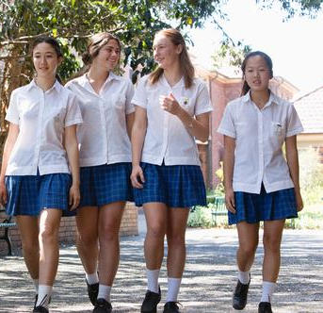
Available URL: https://s-media-cache-ak0.pinimg.com/736x/e8/6d/be/e86dbe6cbc7248a0b32028dd3baf8c2f.jpg
Californication. Creator. Tom Kapinos. Showtime Networks, 2007-2014. TV Series
Available URL: https://s-media-cache-ak0.pinimg.com/564x/3e/dd/1f/3edd1f169fb52df433dcd1bcd8c9757a.jpg

Slide 41
Mr. Holland’s Opus. Dir. Stephen Herek. Buena Vista Pictures, 1995. Film
Available URL: https://www.swimmingworldmagazine.com/news/4-comments-that-come-with-life-as-a-female-swimmer/

Slide 42
Mood Board
Water Lilies (Naissance des Pieuvres). Director. Céline Sciamma. Haut et Court, 2007. Film
Breathe (Respire). Director. Mélanie Laurent. Film Movement, 2014. Film
Mustang. Director. Deniz Gamze Urgüven. Ad Vitam Distribution, 2015. Film
Breathe (Respire). Director. Mélanie Laurent. Film Movement, 2014. Film
Water Lilies (Naissance des Pieuvres). Director. Céline Sciamma. Haut et Court, 2007. Film
Available URL: http://www.tfaforms.com/forms/get_image/136268/coach_demo.jpg
Breathe (Respire). Director. Mélanie Laurent. Film Movement, 2014. Film
Mustang. Director. Deniz Gamze Urgüven. Ad Vitam Distribution, 2015. Film

Slide 43
Camera and Lighting
Like my reference films – Friday Night Lights (2006-2011) and Kids (1995) – I intend to capture a hand-held shooting style, something akin to documentary realism. As such, in composing the shots, each frame should look and feel like it is happening in real time, almost as if we are shooting for live television.
I intend on using multiple camera angles and set-ups, such as medium and medium close-ups, so that I am able to ensure a variation of shot size in order to control the audience’s empathy for the characters. The shooting style will also lend itself to using the zoom and jumping the 180-degree line of sight for specific dramatic effect in order to de-stabilize a scene at particular times. It is also important to note that the camera will constantly be moving and following the characters allowing them the opportunity and freedom to let the scene happen organically.
Given the documentary realism I intend to shoot for, I am opting for the use of natural/ambient, motivated and practical lighting sources as opposed to using extra lights that I believe would diminish the quality and realism of the shot. Additional lighting will only be used to purely compliment what light is readily available.

Slide 44
PLEASE SEE THE VIDEO FILE – 3. CAMERA AND LIGHTING REFERENCE

Slide 45
Edit and Grade
I intend for the edit to match the hand-held documentary-like shooting style (with multiple camera set-ups) so that I am better able to manipulate the rhythm, pace and dramatic tension of any given scene. In order to achieve this, I will not only edit on the action, but on the emotional beats as well. I also intend to use slightly longer takes in order to exemplify documentary-like realness.
In controlling how the narrative unfolds, the edit will align itself with the subjective/emotional point-of-view of the scenes, which will ultimately be dictated and told from the protagonist’s (Ryann’s) point-of-view. This will allow audiences to build an emotional rapport with her and her plight.
Additionally, I intend for the colour grade to compliment the muted colours of the palette in order to amplify the documentary feel.

Slide 46
PLEASE SEE THE VIDEO FILE – 4. EDIT AND GRADE REFERENCE

Slide 47
Film Reference Clips
The below reference is a clip from the television show Friday Night Lights (Berg, 2006-2011) which captures the hand-held documentary-like shooting and editing style that I am aiming for.
PLEASE SEE THE VIDEO FILE – 5. FILM REFERENCE ONE

Slide 48
The below reference clip is a dialogue driven scene from case study Kids (1995) which captures the hand-held documentary-like shooting and editing style that I am aiming for.
PLEASE SEE THE VIDEO FILE – 6. FILM REFERENCE TWO

Slide 49
Music and Score Reference Clips
In terms of the music and score, I have selected reference clips that illustrate the emotional resonance that I intend to use to support the mood of a scene, character’s emotional state, and the overall story. In doing so, it will assist audiences in understanding the internal conflicts of the characters.
The music used in the film will be incidental/background music (sounds that will be used on location and motivated by radio and cellphone). The score and theme of the film will be used to create mood by underling the dramatic tension within a scene and expose the emotional inner life of the characters whilst accentuating the conflict in a scene.
The songs below are reference clips only. My intention is to have original music and score composed for the film that is able to evoke similar emotions and nostalgia that will support the mood of a scene, character’s emotional state and the overall story.

Slide 50
Song One
Title: Forever Young
Artist: Unknown (Cover Song)
Song Three
Title: That’s the Way
Artist: Led Zeppelin
PLEASE SEE THE VIDEO FILE – 7. SONG ONE
PLEASE SEE THE VIDEO FILE – 9. SONG THREE
Song Two
Title: Wish You Were Here
Artist: Sparklehorse
Song Four
Title: Elevator beat
Artist: Nancy Wilson
PLEASE SEE THE VIDEO FILE – 8. SONG TWO
PLEASE SEE THE VIDEO FILE – 10. SONG FOUR
Song Five
Title: Not About Angels
Artist: Birdy
PLEASE SEE THE VIDEO FILE – 11. SONG FIVE

Slide 51
Shooting Schedule

Slide 53
Gear List; Camera, Lighting, and Sound
2 x Sony A7S2 (including EVF, PL Mount, Batteries, Media Cards & Reader)
2 x Cooke S4 Lens Kit (15-40cxx, 21mm, 35mm, 50mm, 75mm, 180mm)
2 x Handheld Shoulder Rigs
2 x Mattebox & Filters (ND 3, 6, 9, 1.2, Pola)
1 x Carmount (Mowkit)
1 x Lowboy
1 x Tall Legs
1 x Baby Legs
6 x Kino Flo 4ft 4 Bank
1 x 12v Single Kino Flow
3 x 350s and Stands
2 x 1.2 HMI
2 x 4x4 Scrim Frames
2 x Combo Stands
8 x C Stands
1 x Flag Kit
2 x Big Poly
1 x Small Poly
(White and Silver)
1 x Dolly
3 x 2m Tracks
Sound Kit

Slide 54
Budget

Slide 55
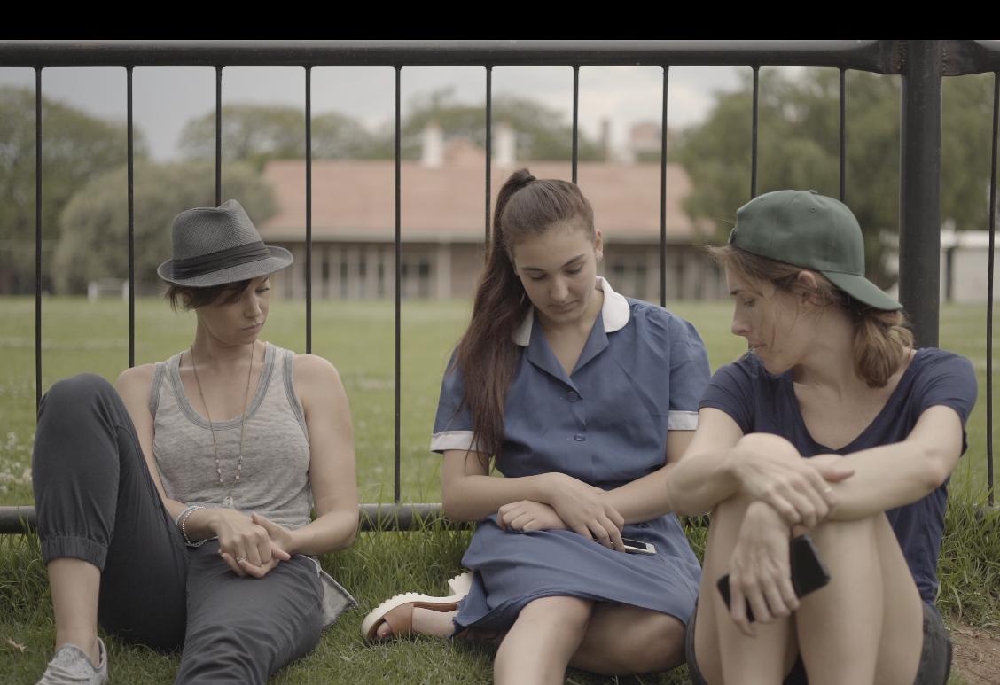
Poster Image Idea
(S)he

