Slide 1


Reprographic and Digital Services at the National Library of South Africa: an overview
Douwe Drijfhout
Executive Librarian
Preservation Services

Slide 4
National Library of South Africa
Cape Town campus (1818)
Pretoria campus (1887)
e Ntional Librarian is a member of NCLIS

Slide 5
Heritage Collections
Primary source of SA published documentary heritage
Wealth of information
Books, periodicals, newspapers, maps, special collections, government publications, foreign official publications
e Ntional Librarian is a member of NCLIS

Slide 6
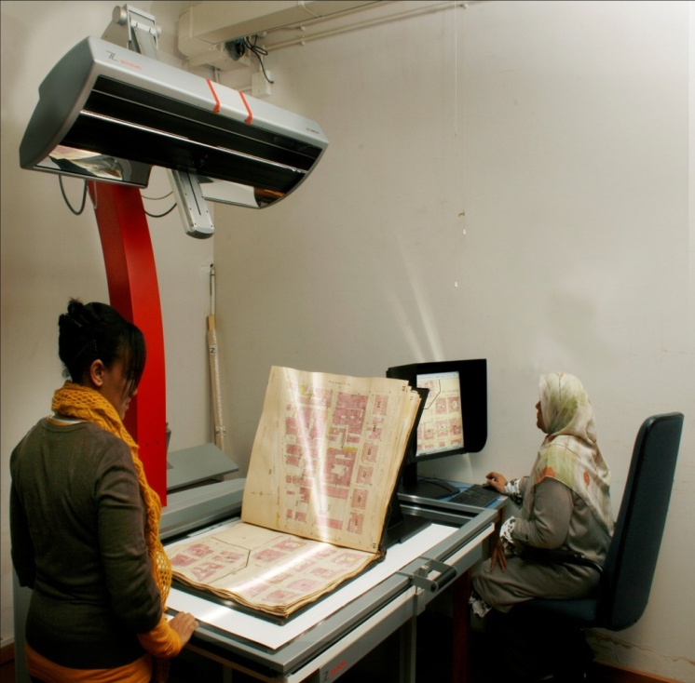
Reprographic and Digital Services

Slide 7
On demand
Photography & microfilming: transformed
Existing staff
Film scanner (neg + mf)
Digital cameras
Large-format scanners
Digital video
e Ntional Librarian is a member of NCLIS

Slide 8
First years
DISA
Research
Pilot projects
On demand
e Ntional Librarian is a member of NCLIS

Slide 9
Digital Innovation South Africa
1997-2009: DISA
Implement digital technologies in libraries
Socio-political interest
SA Freedom Struggle
DISA: training and support
Journals (40+)
Archival collections
220 000 images/pages
e Ntional Librarian is a member of NCLIS

Slide 10
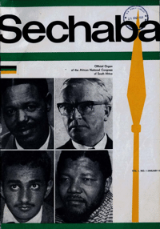
Sechaba: 1 (1) 1967

Slide 11
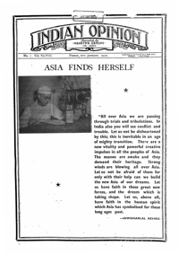
Indian Opinion: 48 (1) 1950

Slide 12
Research
Legal deposit of web-based publications (2004)
Digitisation in Africa (2005)
SA policies en legislation (2007)
Software
e Ntional Librarian is a member of NCLIS

Slide 13
Training
Metadata for librarians
Software: Greenstone / DSpace
Multimedia & graphics
Digital photography
e Ntional Librarian is a member of NCLIS

Slide 14
Pilot projects
UNESCO Memory of the World (300 drawings by SAN) - 2003
LOCKSS-SA (2004)
COM – newspaper (2006)
e Ntional Librarian is a member of NCLIS

Slide 15
Future plans
SA newspapers
Approx 7.5 million pages
Black Press
200 000 pages
e Ntional Librarian is a member of NCLIS

Slide 16
Stages: Black Press
1830-1880: Christian Missionaries
1880-1930: Independent Protest Press
1940-1960: From Protest to Resistance
e Ntional Librarian is a member of NCLIS

Slide 17
Definition
According to readership
African, Indian & Coloured audience
Not all owned or edited by
Bi-lingual: English +
Zulu, Xhosa, Tswana, Sotho
e Ntional Librarian is a member of NCLIS

Slide 18
1830-1880
Christian Missionaries
Two publishing centres
Lovedale Mission Press (Presbyterian)
Morija Printing Works (Paris Evangelical)
Lovedale -> Xhosa
Morija -> Sotho
e Ntional Librarian is a member of NCLIS

Slide 19
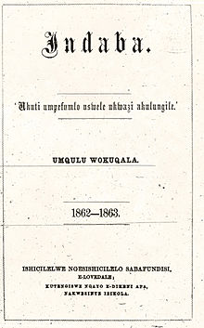

Slide 20
1880-1930
Independent Protest
New generation
African nationalist newspapers
Black literary tradition
First political bodies
e Ntional Librarian is a member of NCLIS

Slide 21
Leaders
John Jabavu: Imvo Zabatsundu (1884)
Walter Rubusana: Izwi Labantu (1897)
Solomon Plaatje: Koranta ea Becoana (1901)
John Dube: Ilanga lase Natal (1903)
Mahatma Gandhi: Indian Opinion (1903)
Abdullah Abdurahman: APO (1909)
e Ntional Librarian is a member of NCLIS

Slide 22
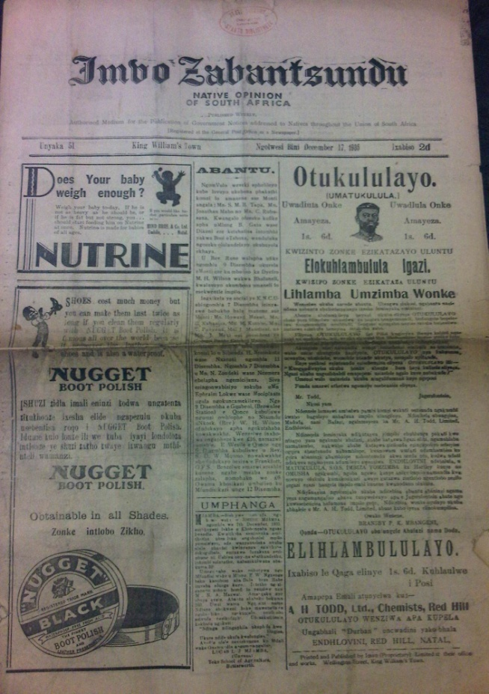
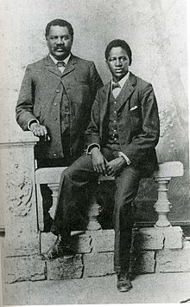
John Jabavu:
Imvo Zabatsundu (1884)

Slide 23
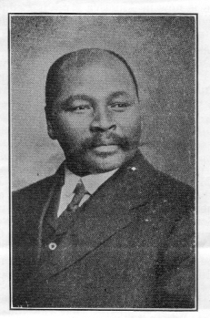
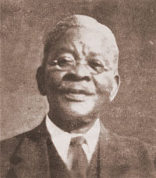
Rubusana & Dube

Slide 24
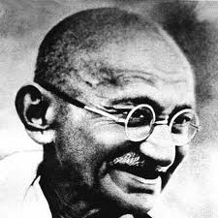
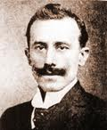
Abdurahman & Gandhi

Slide 25
1940-1960
Protest to Resistance
Great Depression mid-30s
Critical years
Trek to cities
1948-election
e Ntional Librarian is a member of NCLIS

Slide 26
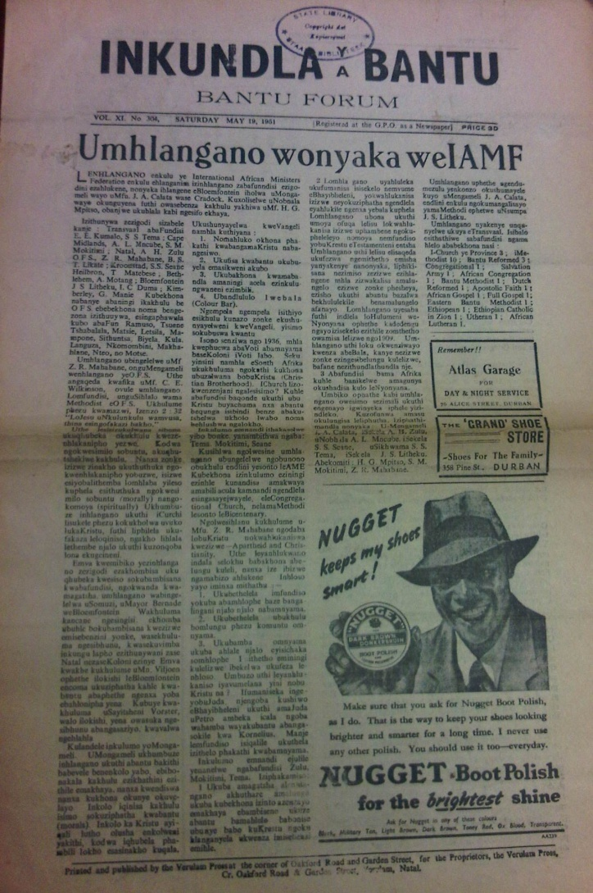
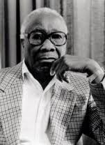
Govan Mbeki:
Inkundla ya Bantu (1938)

Slide 27
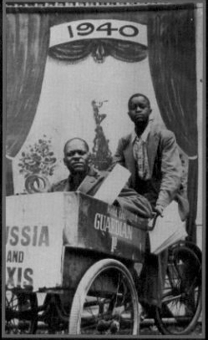
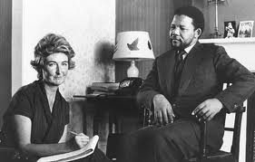
Ruth First

Slide 28
Policy development
National policy
Guidelines
Coordinate and protect
Draft tabled Feb 2011
e Ntional Librarian is a member of NCLIS

Slide 29
Draft policy
Role of existing memory institutions
National Digital Repository
Inclusive info society
Develop institutional capacity
e Ntional Librarian is a member of NCLIS

Slide 30
Building digital collections
Digitisation: converting
Acquisition: original digital works
Access to external resources
e Ntional Librarian is a member of NCLIS

Slide 31
Deposit of e-publications
Model developed
Accept original digital works
Web-based protocol
e Ntional Librarian is a member of NCLIS

Slide 32
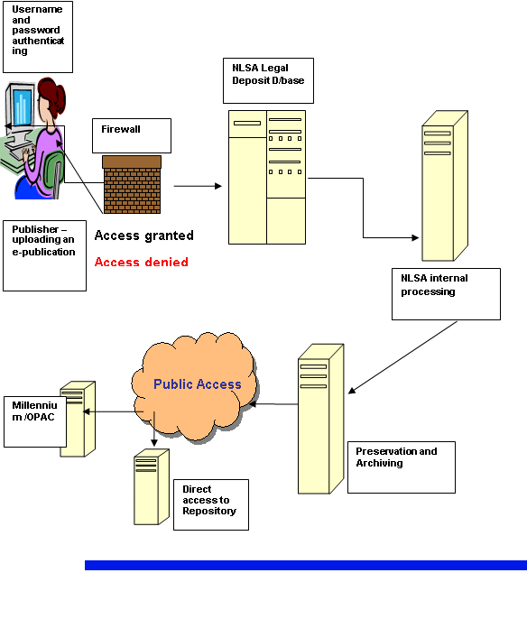
e-deposit model

Slide 33

Thank you!
douwe.drijfhout@nlsa.ac.za
+27 12 401 9700
www.nlsa.ac.za

