Slide 1
Trusted Digital Archives. Experiences from the Landesarchiv Baden-Württemberg, nestor and DIN
Dr. Christian Keitel
Johannesburg, 27/2/2013

Slide 2
Table of Contents
Some fundamental concepts
Solutions of the Landesarchiv Baden-Württemberg
DIN-Standard 31644 and nestor-certification

Slide 3
Trusted Traditional Archives
Archives were old and hence trustworthy.
  „Can I trust the archive?“ >>>
  Ius archivi/concept of unbroken custody (jurisprudence)
Archival objects were regarded as authentic.
  „Are the objects what they purport to be?“ >>> Examination of data carrier and information (diplomatics)

Slide 4
Trusted Digital Archives?
Archives are young were old and hence trustworthy.
  „Can I trust the archive?“ >>>
  Ius archivi/concept of unbroken custody (jurisprudence)
Archival objects were regarded as authentic.
  „Are the objects what they purport to be?“ >>> Examination of data carrier and information (diplomatics)

Slide 5
Report of the Task Force on Archiving of Digital Information (1995)
“Repositories claiming to serve an archival function must be able to prove that they are who they say they are by meeting or exceeding the standards and criteria of an independently-administered program for archival certification.”
Claiming trustworthiness by means of diplomatics.
Any more questions about the authenticity of digital objects?

Slide 6
The New Landscape
All users should get the opportunity to check the authenticity of archival objects (digital diplomatics)
  Landesarchiv Baden-Württemberg
All users should get information about the trustworthiness of the archive (criteria catalogues)
  Nestor and DIN

Slide 7
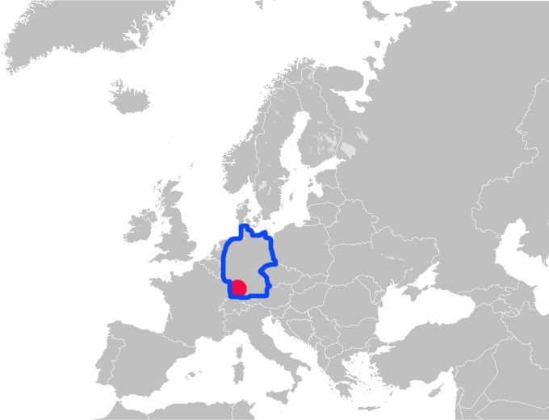
Baden-Württemberg and Germany

Slide 8
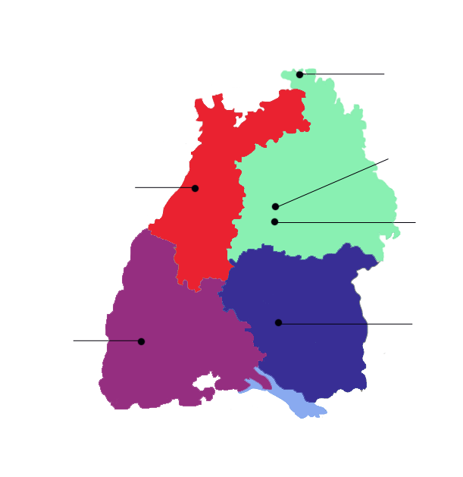
Landesarchiv Baden-Württemberg
Staatsarchiv Wertheim
Staatsarchiv Ludwigsburg inkl.
Hohenlohezentralarchiv Neuenstein
Generallandesarchiv Karlsruhe
Hauptstaatsarchiv Stuttgart
Staatsarchiv Sigmaringen
Staatsarchiv Freiburg
50 km

Slide 9
Digital Preservation in Baden-Württemberg
1974 First 2-day workshop
1987 Archive law: Machine-readable information is equal to paper documents
2002 First digital object archived
2006 Programming of DIMAG

Slide 10
The Problem
Digital preservation needs to store digital objects in a concrete physical way
  Specific carrier
  Specific file
  Specific file format
  …
The physical manifestations have a short lifetime
Transfers to other manifestations are unavoidable
How to maintain authenticity?

Slide 11
Enabling the User to Get His Questions Answered
Task can‘t be postponed
Digital preservation knows two states and four means to maintain authenticity
  (1) Maintain integrity via hash values (frozen state)
  (2) Maintain authenticity via metadata (transition state)
  (3) Maintain a net of references
  (4) Document what you do

Slide 12
(1) Hash Values (Frozen State)
Each DIMAG file has its own hash-value-file
DIMAG recalculates the hash values and compares them with the value in the hash-value-file
  New files: every day
  All files: every week

Slide 13
How We Obtain Historical Information
Author
Reality
User
Original text
Archival object
t
Creation date
Date of use

Slide 14
How We Trace Back Our Digital History
Author
Reality
User
Original digital text
The fifth copy
t
Creation date
Date of use

Slide 15
Task…
Author
Reality
User
Compare each copy with its predecessor
Original
Copy1
Copy2
Copy3
Copy4
Copy5
t
Creation date
Date of use

Slide 16
…Problem…
Author
Reality
User
Originaltext
Copy1
Copy2
Copy3
Copy4
Copy5
t
Creation date
Date of use

Slide 17
…and Solution
Author
Reality
User
Original
Copy1
Copy2
Copy3
Copy4
Copy5
MD
Original
MD
Copy 1
MD
Copy 2
MD
Copy 3
MD
Copy 4
t
Creation date
Date of use
MD = Metadata

Slide 18
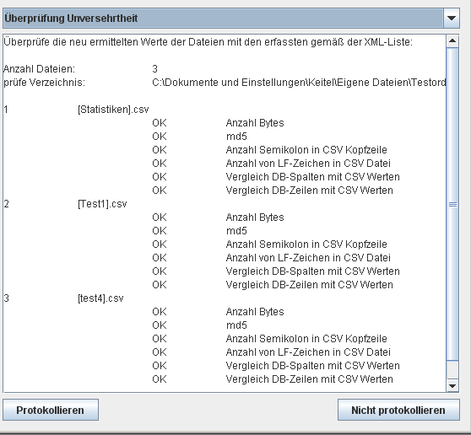
(2) Metadata (Transition State) - IngestList
Catch central metadata of the objects to be archived (significant properties) as early as possible
  Count fields and rows of the original data base table
  Export tables as csv
  Count rows and field delimiters of the csv
  Compare metadata (number of rows and fields/field delimiters)

Slide 19
  (3) Maintain a Net of References
Metadata
Metadata
Document 1
Metadata
Metadata
Document 2
Metadata

Slide 20
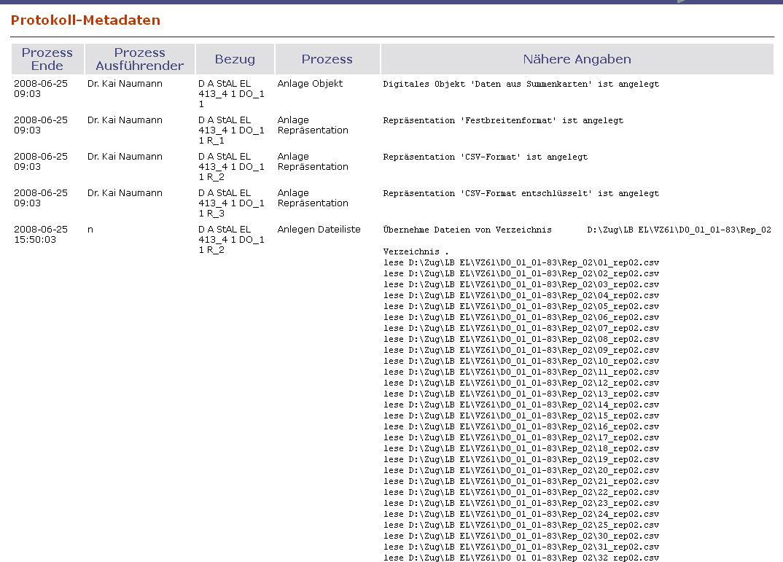
  (4) Document What You Do - DIMAG

Slide 21
  (4) Document What You Do- DIMAG
Internal procedures
XML-schemes
File format descriptions
…
DIMAG handles these documents as if they were genuine archival objects

Slide 22
The International Landscape
ISO 16363: 2012 – 109 criteria
  Certification process by external experts (ISO 16919)
DIN 31644: 2012 – 34 criteria
  Extended peer-reviewed self-assessment or certification by external experts
Data seal of approval – 16 criteria
  Peer-reviewed self-assessment
European Framework for Audit and Certification of Digitial Repositories http://www.trusteddigitalrepository.eu

Slide 23
The National Landscape
Working groups at
  nestor, the German competence network for digital preservation (founded in 2002)
  DIN, the German Institute for Standardization
Main developments
  Criteria catalogue (DIN 31644, predecessor at nestor)
  Certification versus DIN 31644 (nestor)

Slide 24
DIN 31644
Purpose: Trustworthiness of the archive
No compulsory technical implementation
4 principles: Documentation, transparency, adequateness, measurablity
34 criteria
C 1 | Selection of information objects and representations
The digital archive has defined criteria for the selection of information objects and representations. The scope is limited by legal regulations, by the institution‘s mission, and by further objectives.
Published criteria for the selection

Slide 25
C14 Integrity: Ingest interface
C15 Integrity: Functions of the archival storage
C16 Integrity: user interface
C17 Authenticity: Ingest
C18 Authenticity: Preservation measures
C 19 Authenticity: Use
C20 Technical authority
C21 Transfer packages
C 22 Transformation of the transfer packages into archival packages
C 23 Archival packages
C 24 Interpretability of the archival packages
C 25 Transformation of archival packages into access packages
C26 Access packages
C27 Identification
C28 Descriptive metadata
C29 Structural metadata
C30 Technical metadata
C31 Logging the preservation measures
C32 Administrative metadata
C33 IT infrastructure
C34 Security
C1 Selection of information objects and their representations
C2 Responsibility for preservation
C3 Designated communities
C4 Access
C5 Interpretability
C6 Legal and contractual basis
C7 Legal conformity
C8 Funding
C9 Personnel
C10 Organisation and processes
C11 Preservation measures
C12 Crisis / successorship management
C13 Significant properties

Slide 26
C14 Integrity: Ingest interface
C15 Integrity: Functions of the archival storage
C16 Integrity: user interface
C17 Authenticity: Ingest
C18 Authenticity: Preservation measures
C 19 Authenticity: Use
C20 Technical authority
C21 Transfer packages
C 22 Transformation of the transfer packages into archival packages
C 23 Archival packages
C 24 Interpretability of the archival packages
C 25 Transformation of archival packages into access packages
C26 Access packages
C27 Identification
C28 Descriptive metadata
C29 Structural metadata
C30 Technical metadata
C31 Logging the preservation measures
C32 Administrative metadata
C33 IT infrastructure
C34 Security
C1 Selection of information objects and their representations
C2 Responsibility for preservation
C3 Designated communities
C4 Access
C5 Interpretability
C6 Legal and contractual basis
C7 Legal conformity
C8 Funding
C9 Personnel
C10 Organisation and processes
C11 Preservation measures
C12 Crisis / successorship management
C13 Significant properties

Slide 27
C14 Integrity: Ingest interface
C15 Integrity: Functions of the archival storage
C16 Integrity: user interface
C17 Authenticity: Ingest
C18 Authenticity: Preservation measures
C 19 Authenticity: Use
C20 Technical authority
C21 Transfer packages
C 22 Transformation of the transfer packages into archival packages
C 23 Archival packages
C 24 Interpretability of the archival packages
C 25 Transformation of archival packages into access packages
C26 Access packages
C27 Identification
C28 Descriptive metadata
C29 Structural metadata
C30 Technical metadata
C31 Logging the preservation measures
C32 Administrative metadata
C33 IT infrastructure
C34 Security
C1 Selection of information objects and their representations
C2 Responsibility for preservation
C3 Designated communities
C4 Access
C5 Interpretability
C6 Legal and contractual basis
C7 Legal conformity
C8 Funding
C9 Personnel
C10 Organisation and processes
C11 Preservation measures
C12 Crisis / successorship management
C13 Significant properties

Slide 28
The User‘s Questions
C 19 | Authenticity: Use
The digital archive allows the user to evaluate the object’s authenticity and enables the administration of the archive to preserve it….
Documentation of the processes
C 31 | Logging the preservation measures
The digital repository logs the preservation measures and any changes to the representations.
Logs

Slide 29
Adequateness
Implementations must be consistent with the archive’s objective.
An example: An archive wants to preserve just the text of web sites (no pictures, no sounds…)
  For a political archive of East Asia studies, it might be sufficient.
  For the archive of an academy of arts, it‘s not enough.

Slide 30
Nestor Certification - Overview
Discussed since 2004
Nestor working group on certification started in 2010
Part of the European framework for certification of digital repositories
Pilot certification of the German National Library
Extended certification starts in 2013

Slide 31
Extended Certification -Process
Defining the scope
All criteria applicable?
Questions for each criterion
  Current conditions?
  Rating?
  Documentation?
Evaluation by 1st reviewer
Fixing by 2nd reviewer

Slide 32
C 21 | Transfer packages
The digital repository has issued specifications regarding its transfer packages. The digital repository agrees with the producers on the transfer packages to be ingested (content data and metadata). The transfer packages are checked on the basis of the specifications.
Which specifications does the digital repository have regarding transfer packages? Which content data are acceptable? Which metadata are required? Are there special requirements and processes for the creation of transfer packages?
Which measures exist for validating the conformity of transfer packages?
Will the repository reject defective transfer packages before ingesting, or will it take corrective measures within a defined work area?

Slide 33
Prospects
Extended certification rollout in 2013
The nestor working group on certification will address formal certification in 2013
English translation of DIN standard and/or guidance document in 2013

Slide 34
Questions?
christian.keitel@la-bw.de
++49 711 212 4276

